Slide 1
Advertising Across Platforms
L4

Slide 2
Lesson Objective
At the end of this lesson we will have studied how antiperspirant/deodorant adverts are marketed towards men and women.

Slide 3
Starter
Antiperspirant – How would you effectively sell it?
What need(s) would you target?

Slide 4
Task
Consider the following print advertisements.
Make notes using the ‘notes’ function at the bottom of the page, commenting on how the adverts try to sell the product.

Slide 5
Remember to…..
Take note of:
Use of slogans
Use and placement of text
Font type, size and colour
Where the product is placed
The image(s) that accompany product

Slide 9
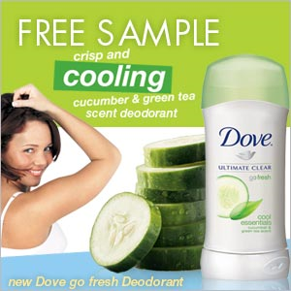

Slide 13
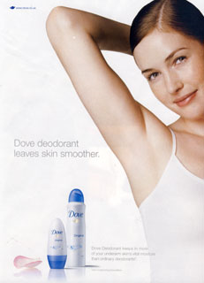

Slide 14
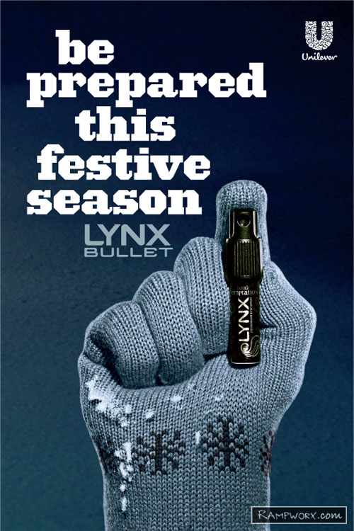

Slide 15
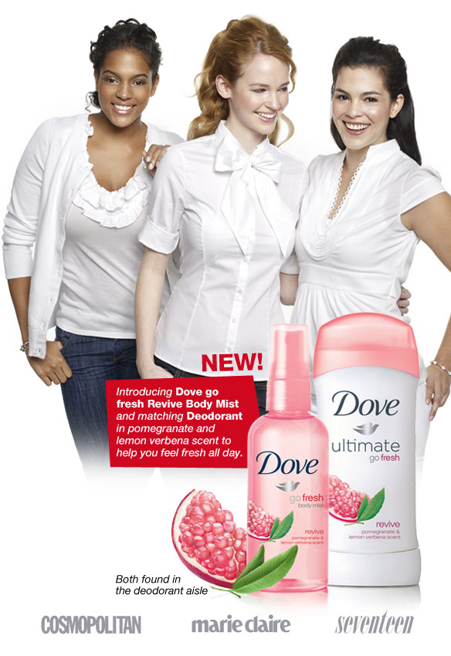

Slide 19
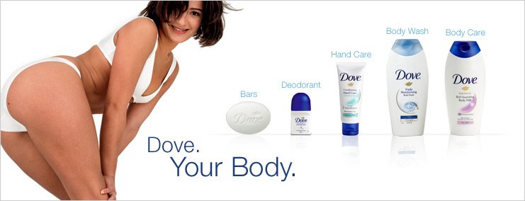

Slide 21
Plenary
Create and complete a table in your books, detailing the codes and conventions used to market deodorant/antiperspirant products to males and females.
MALE PRODUCT CODES AND CONVENTIONS | FEMALE PRODUCT CODES AND CONVENTIONS

Slide 22
SUMMARY
For each topic of focus, write a brief comparison of how the two products are sold to different target audiences. Look at any similarities and differences between the two. Remember, they’re selling the same type of product, just in different way!

