Slide 1
Media Unit
Analysing Persuasive Techniques

Slide 2
Lesson Objective
At the end of this lesson we will have analysed how advertisements persuade people to purchase a specific product.

Slide 3
Starter
What is this advert trying to sell?
How does it try to persuade you to buy it?
Who is the target audience of this advert?
How do you know this?

Slide 4
Analysing Persuasive technique
Advertising tends to follow a basic format:
a slogan or a striking image catches our attention
the body of the ad contains factual information about the product
a pack shot or logo reinforces the brand identity.

Slide 5
We typically only look at magazine adverts for an average time of 1.5 seconds
Yet they can still leave us with an impression of the values that are attached to a brand, and a sense of who the target audience for the product is (male? female? pensioner? teenager?)

Slide 6
Analysing persuasive technique
When first analysing an ad you need to decide
WHAT is the product; why is it a good product to buy?
WHO the ad is aimed at (age group, gender, culture, etc.)?
WHERE/WHEN this ad might appear in order to reach its target audience?
HOW does the advert try to persuade you to buy the product (what do they say)?

Slide 7
The why should be obvious...
Why do any adverts exist?
To sell a
product!

Slide 8
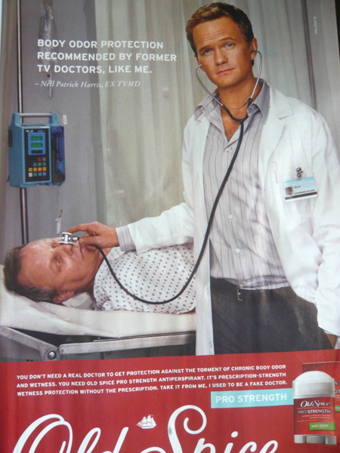
Let’s try it together...
Consider the following advert...
What is being advertised? What is said about the product (the benefits?)

Slide 9
Let’s try it together...
Consider the following advert...
Who is the advert aimed at? How do you know this?

Slide 10
Let’s try it together...
Consider the following advert...
Where would this advert appear (what type of magazine) and when (time of year)?

Slide 11
Let’s try it together...
Consider the following advert...
How does the advert try to get your to buy the product (what does it say)?

Slide 12
Extending the task
Using one of the advertisements you studied last lesson, write a paragraphed response to the following question:
How does the advertisement try to persuade people to buy the product?

Slide 13
For example:
The ‘Old Spice’ advertisement tries to persuade men to buy deodorant by using humour. The picture shows a man, who is the actor Neil Patrick Harris, pretending to be a doctor; he has a stethoscope on the nose of an older man, which is meant to be funny. The advert says that the deodorant can fight ‘chronic body odour’ without the help of a doctor. That way, men don’t have to go to a doctor and feel embarrassed about being smelly. It also takes up less time, and you get the results of a ‘prescription deodorant’, without all the hassle. Instead of using the advice of a doctor, it uses advice from a ‘fake doctor’. This is meant to be funny, and a lot of men would want to buy the product simply because it doesn’t take itself seriously.

Slide 14
Plenary
Swap responses and adverts with someone sitting near you.
Look at the advert, then read the paragraph written by your peer.
Write a brief paragraph underneath the other students response, stating whether you agree or disagree with their analysis.
I agree that the advert is aimed at men because....

