Slide 1
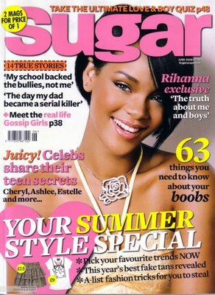
Magazine Media Unit
Lesson 2

Slide 2
Lesson Objective
At the end of this lesson, we will have learnt the conventions used on magazine covers.

Slide 3
Who is this magazine aimed at?
How do you know?

Slide 4
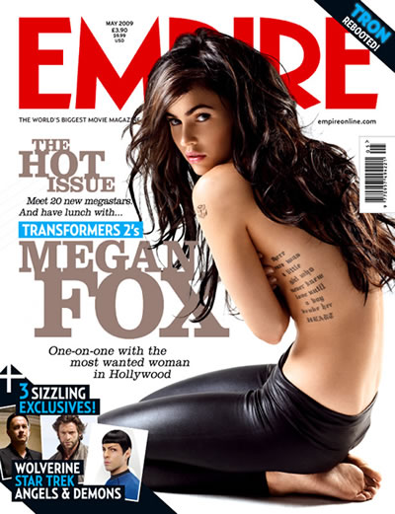
Who is this magazine aimed at?
How do you know?

Slide 5
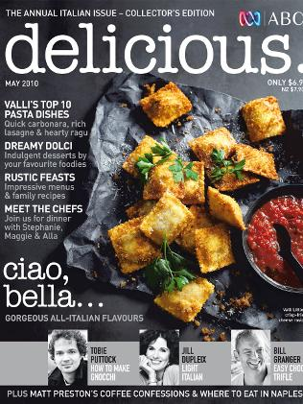
Who is this magazine aimed at?
How do you know?

Slide 6
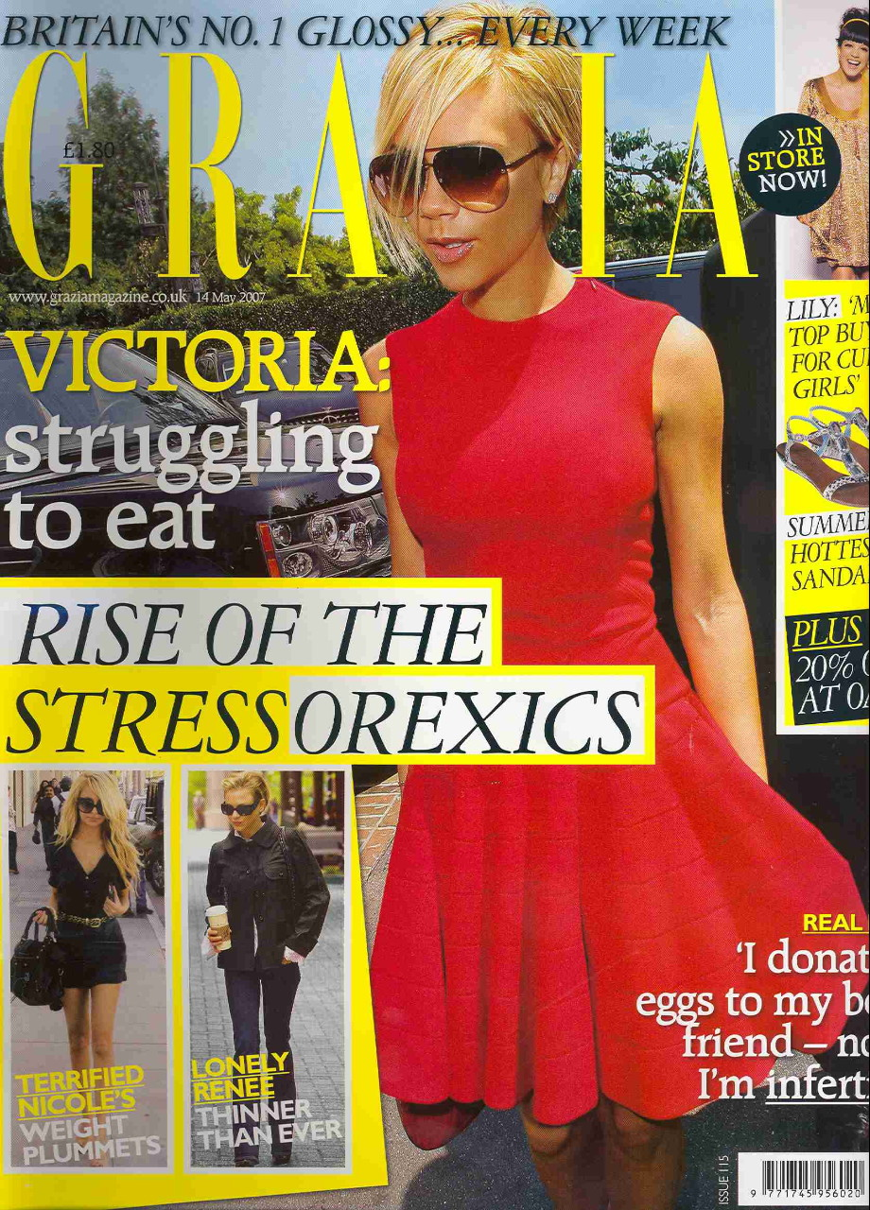
Who is this magazine aimed at?
How do you know?

Slide 7
Conventions of a Cover
What sort of features do all of these covers have in common?

Slide 8
Puffs
Title – masthead
Central image
Price
Graphic features
Anchorage text
Direct mode of address
Buzz word
Images
Plug – info about content
given on cover

Slide 9
Puffs
Title – masthead
Central image
Price
Anchorage text
Direct mode of address
Graphic features
Buzz word
Images
Plug – info about content
given on cover

Slide 10
Features and Conventions: The Cover
Central image
Price
Direct mode of address
Graphic features (fun with text)
Images (beside central image)
Anchorage text
Buzz word
Puffs – word or phrase used to boost status
Title – masthead
Plug – info about content given on cover

Slide 11
Activity
Discuss the front cover on the next slide. Afterwards, you will have approx 10 minutes to write an individual response to the questions that follow.
It is important that you begin to use the correct meta-language and refer closely to the text

Slide 12
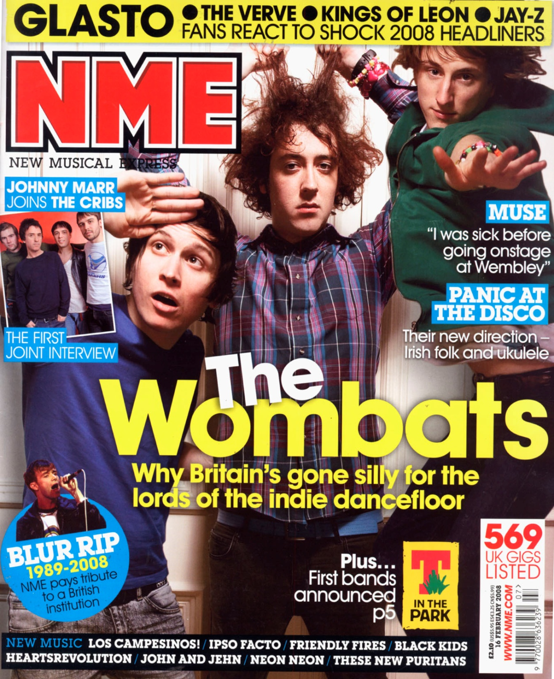
Who is this magazine aimed at?
How do you know?
Make sure you use the correct media terms in your writing and evidence from the text.

Slide 13
Plenary
Sketch and label (using your notes from our lesson today) a magazine cover aimed at male football fans.

