Slide 1
Media Unit
Reading Advertisements

Slide 2
Lesson Objective
At the end of this lesson we will have studied the elements and features of various print advertisements.

Slide 3
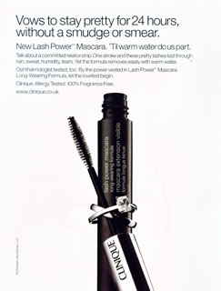
Starter
What is this advert selling?
How does it try to sell it?
Who is the target audience? How do you know this?

Slide 4
 | Clinique Ad
Design features (colour, shape, line, balance, focal point, images)
Text features (font, size, bullets, titles, headings, subheadings, italics, bold, labels, captions)
Intended audience
Possible category

Slide 5
Print advertisements
Ads exist to try to satisfy our needs.
They work by trying to offer you an image of yourself made to look more glamorous, powerful or popular as a result of using a product.
A need is created.

Slide 6
For example...
Do women really need to buy this mascara?
How is desire created in this advert? How do they persuade women to buy it?

Slide 7
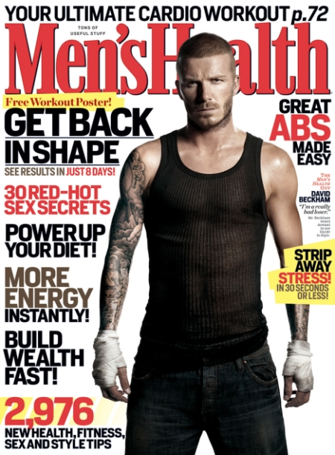
Target Audience
Adverts are targeted at a very specific audience.
For example, would the ‘Clinique’ ad be found in Men's Health magazine? Why not?
What sort of ads would you expect to find in Men’s Health?

Slide 8
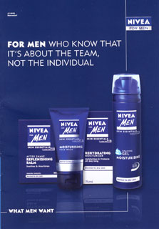
How does this advert try to sell a typically ‘female’ product to men?

Slide 9
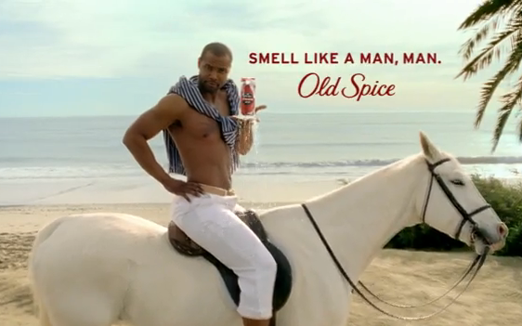
How does this advert try to sell a male product to women?

Slide 10
Analysing print ads
Each table will be given a different magazine.
Carefully look through the magazine, and choose three adverts that you find interesting or effective.
Remove the three from the magazine.

Slide 11
Extending the task
Create a table
 | ADVERT 1 | ADVERT 2 | ADVERT 3
Design features (colour, shape, line, balance, focal point, images)
Text features (font, size, bullets, titles, headings, subheadings, italics, bold, labels, captions)
Intended audience
Possible category

Slide 12
Extending the task
What were your adverts trying to sell?
How did they try to sell the product?
Were there any common techniques that were used in your adverts?
Can you begin to make generalizations about all adverts in a given category? i.e. All beauty adverts… All men’s adverts… All food adverts…
Why do you suppose the product was advertised in your particular magazine?

Slide 13
Presenting
Assemble what you’ve learnt so that you can present your findings to the rest of the class.

Slide 14
Plenary
Were there similarities between the ads presented?
Did groups recognize similar codes and conventions?

Slide 15
Extended PLENARY
Choose one of the following categories of advertisement, and create your own example on a blank sheet of paper. 1) Male beauty 2) Female beauty 3) Male or female fragrance 4) Food 5) Car 6) Technology 7) Male or female fashion

