Slide 1
Creative Media
Lesson 1: Intro to the Course

Slide 2
Lesson Objective
At the end of this lesson we will have discussed the outline of the course, and completed a quiz to assess your media knowledge.

Slide 3
Starter
MEDIA
What is it?

Slide 4
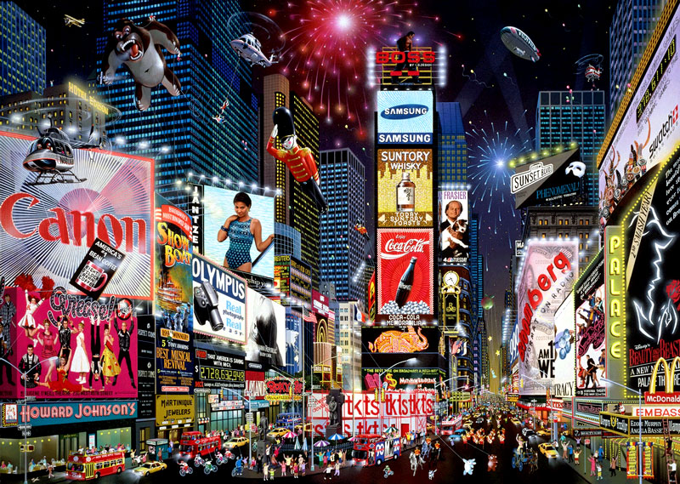
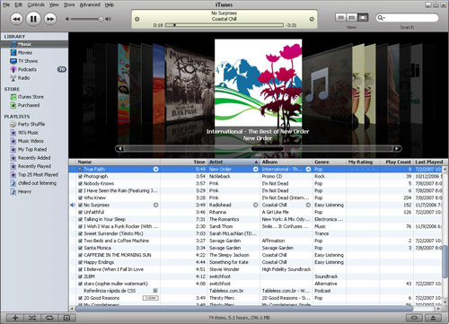
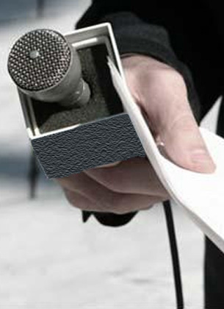

Slide 5
How will I be marked?
60% of your grade comes from your coursework folder
4 written assessments
Will focus on three different media text types
Practical production (with a written supporting document)
A hands on, practical project that incorperates research, your ability to adapt and develop ideas for your target audience, and appropriate use of technology.
40% of your grade comes from one written exam at the end of Year 11.

Slide 6
Units and Assessment
Autumn Term
Learn the key concepts of media studies
Watch and deconstruct ‘Truman Show’ using MAIR concepts (one hour controlled assessment)
Analysis of television – how do the opening scenes of certain programs grab viewer attention (controlled assessment )

Slide 7
Units and Assessment
Spring Term
Study of advertising across two platforms – print and web/television (controlled assessment - write 800 word analysis comparing)
Produce own pre-production mock-up of a cross platform advertised product – a print/viral video storyboard.

Slide 8
Units and Assessment
Summer Term
Magazine study/film study – produce 4 pages of niche market magazine, accompanied by a 1000 word personal evaluation of the final production (controlled assessment) OR produce an original film trailer/opening moments of an original film.

Slide 9
KEY TERM: Semiotics
Definition: The study of SIGNS
Examines how symbolic, written and technical signs construct meaning
Looks at how meaning is made and understood

Slide 10
KEY TERMS: Signifier & Signified
THE SIGNIFIER – The sign: a word, colour or image (i.e. the colour BLUE)
THE SIGNIFIED – The concept/ meaning/associations that the sign refers to (i.e. BLUE is often associated with sadness or the sea etc.)

Slide 11
Signifier & Signified: Examples
Signifier: Red rose with a green stem
Signifies: a symbol of passion and love - this is what the rose represents
Signifier: Brown cross
Signifies: a symbol of religion, or to be more specific this is a symbol of Christianity
Signifier: Heart
Signifies: a symbol of love and affection

Slide 12
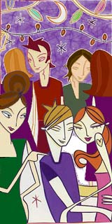
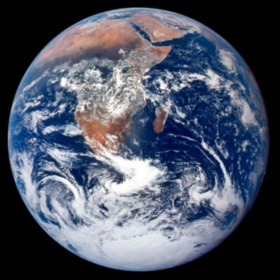
TASK: Green What does ‘green’ signify?
=

Slide 13
TASK: Pink
What does the colour ‘pink’ signify when used on this magazine cover? List five signifiers.

Slide 14
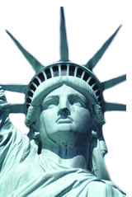
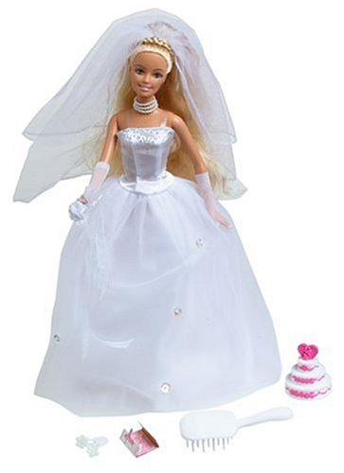
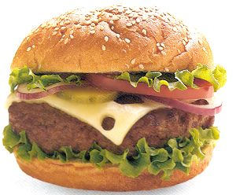
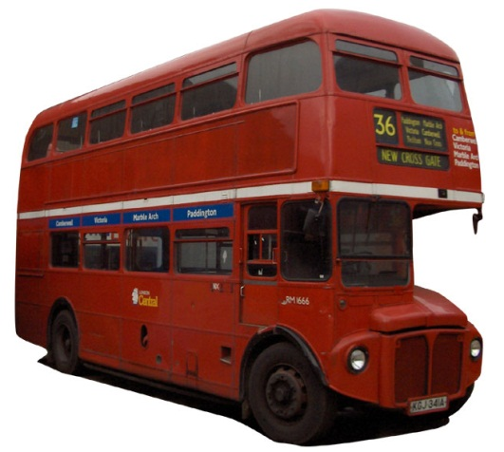
TASK: What do the following signs signify? Make a list of all the meanings and associations you can think of for each signifier:
B
A
C
E
D

Slide 15
A: Barbie Doll

Slide 16
B: Hamburger

Slide 17
C: The Statue of Liberty

Slide 18
D: Bus

Slide 19
E: Nike Swoosh

Slide 20
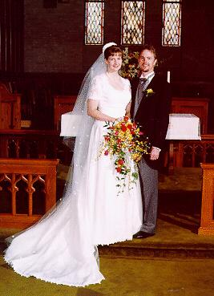
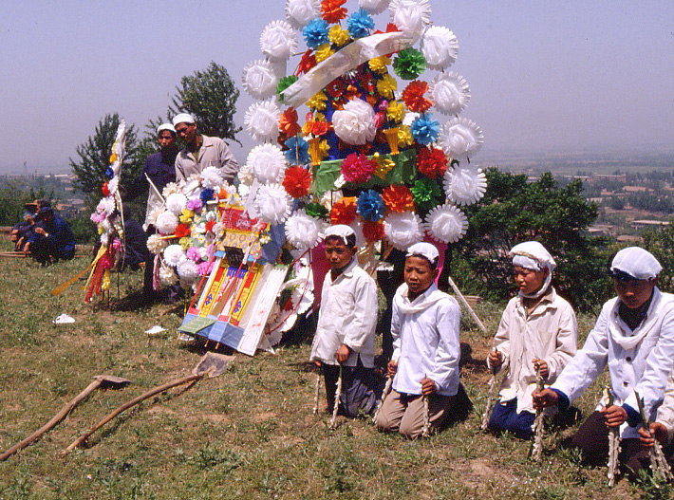
Signs & Cultural Differences
How we read a sign depends on our culture:
EXAMPLE: In Britain, we associate the colour white with innocence, purity, weddings
In China, white is the colour of mourning and is worn at funerals

Slide 21
How to read the signs and signifiers within a Media Text
All media texts have 2 layers of meaning:
DENOTATIVE LEVEL: What we actually see (sign)
CONNOTATIVE LEVEL: What you associate with this image (signifier)

Slide 22
KEY TERMS 3: Denotation & Connotation
Denotative: The surface meaning
Connotative: The deeper or hidden meanings and associations

Slide 23
This image denotes the movie star Marilyn Monroe

Slide 24
The image connotes glamour, stardom, sexuality, beauty
If this was one of the last photographs of Marilyn Monroe, we may also associate it with her depression, drug-taking and ultimately death

Slide 25
This image denotes a tropical island
The image connotes peace, tranquility paradise, holiday, summer to some readers.
…but think about the film ‘Castaway’, the victims of the Bali bombings or the recent tsunami - in this case the image may connote isolation, fear or even death
It is important to note that images have different connotations depending on the reader of the image/text

Slide 26
Denotation & Connotation within a Media Text – A Movie Poster
The Mission Impossible Poster denotes a MATCH and a GLOBE OF THE WORLD
What are the connotations of
The match?
The globe?

Slide 27
TASK: Denotation & Connotation within a Media Text – A Movie Poster
What are the key signifiers in the movie poster and what do they signify?
What are the denotative levels of meaning in the poster? (What does the poster denote?)
What are the connotative levels of meaning in the poster? (What does the poster connote?)
What are they communicating to an audience? Why?

Slide 28
Assessing Your Media Knowledge
In order for me to understand your current knowledge about the media, you need to complete the following multiple choice test.
Circle the answer that you think is most correct.
We will peer mark them upon completion.

