Slide 1
Creative Media
Unit 1 Lesson 10

Slide 2
Lesson Objective
At the end of this lesson we will have discussed various representations in the media.

Slide 3
Starter
Create a mind map of words and phrases you associate with the following Representation

Slide 4
Representation
The way in which people, places or events are re-presented to audiences.
Designed to be believable, however if you look closely they are often stereotypical.
Consider the following clip of advertisements.

Slide 5
Consider how the following key groups are typically represented in film….
women

Slide 6
Consider how the following key groups are typically represented in film….
men

Slide 7
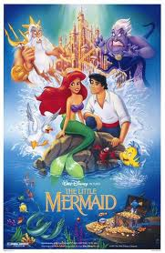
Watch the following clip, commenting on how men and women are represented.

Slide 8
Men
There are common stereotypes of men in the media. These include:
The joker
The jock
The strong silent type
The big shot
The action hero
The buffoon

Slide 9
Women
There are also common stereotypes of women in the media. Women are often seen as:
Sex objects
Weak – dependent on men
Easily frightened
Emotional
Hysterical
Less intelligent

Slide 10
Consider how the following key groups are typically represented in film….
children

Slide 11
Children are often portrayed in the media or films in negative or stereotypical ways. For example, based on an analysis by British 18-year-olds of British newspapers, students identified what they perceived to be seven stereotypes of children in the media:
Kids as victims.
Cute kids sell newspapers.
Little devils.
Kids are brilliant.
Kids as accessories.
“Kids these days.”
Brave little angels

Slide 12
Consider how the following key groups are typically represented in film….
teens

Slide 13
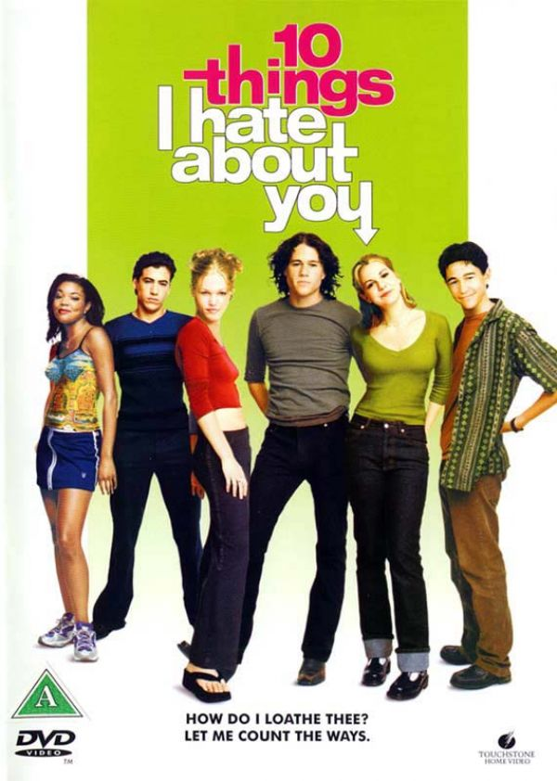
Watch the following clip, taking notes on how teenagers and adults are represented.

Slide 14
Teens
Adolescents are also represented as members of prototypical groups — jocks, nerds, druggie, brains, underdogs, athletes, etc.
They are often shown as disrespectful, moody and selfish.

Slide 15
Consider how the following key groups are typically are represented in film….
The
elderly

Slide 16
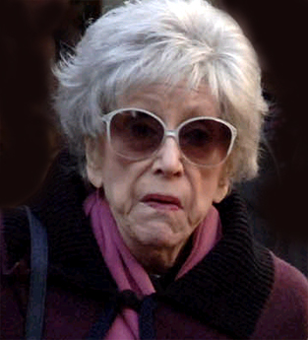
Watch the following clip, commenting on how the elderly are portrayed.

Slide 17
The elderly are often represented in equally limited ways.
Under-represented in the media; A study sponsored by Children Now of prime time television programs in the Fall of 2000 found that only 3% of the characters were 70 and older, and only 13% fell between the ages of 50 and 69.
The reality is that 9% of the American population is over 70 and 28% are over 50. There was also a gender bias; only 19% of women were over age 40.

Slide 18
Consider how the following key groups are typically represented in film….
Ethnic
groups

Slide 19
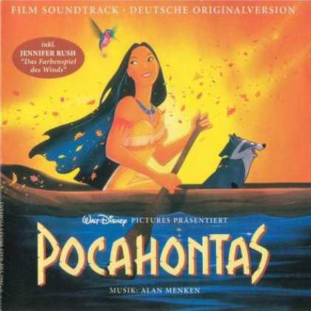
Watch the following clip, taking notes about how different ethnic groups are represented.

Slide 20
Ethnic Groups
Representation of race in the media can consist of the same sort of rigid stereotypes that constitute gender portrayal.
However, stereotyping of race is seen as more harmful than stereotyping of gender, as media representation may constitute the only experience of contact with a particular ethnic group that an audience (particularly an audience of children) may have. Racial stereotypes are often based on social myth, perpetuated down the ages.

Slide 21
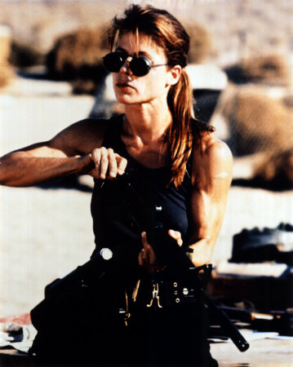
Plenary
Can you think of any films that take the common stereotypes and disregard them?

