Slide 1
Media Studies
Unit 1 Lesson 14
Audience

Slide 2
Lesson Objective
At the end of this lesson we will have studied how audiences are targeted.

Slide 3
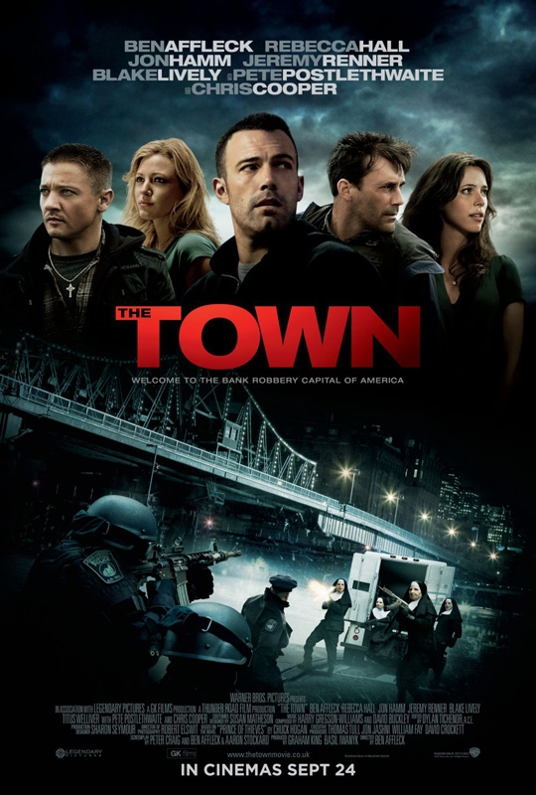
Consider the following film poster. Which audiences do you think are being targeted?

Slide 4
Consider the following film poster. Which audiences do you think are being targeted?

Slide 5
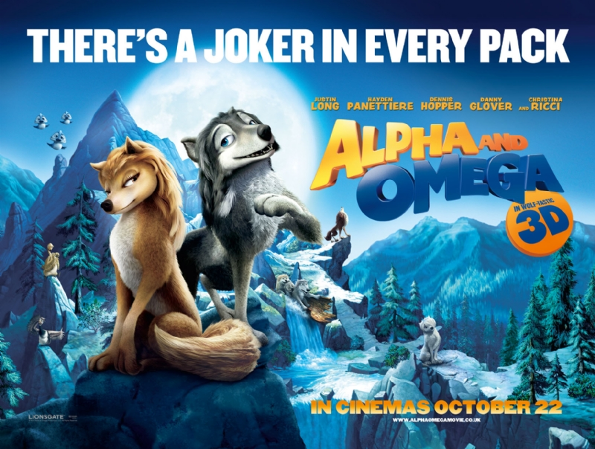
Consider the following film posters. Which audiences do you think are being targeted?

Slide 6
Consider the following film poster. Which audiences do you think are being targeted?

Slide 7
Film Posters
Posters communicate information by the way the images are presented.
The gesture codes (facial expression or body language) of the characters instantly signal violent and disturbing events or romantic and comic moments.
Details like costume, location and lighting also help us read the poster’s message.

Slide 8
Film Posters
The tag line: a short, catchy statement on a film poster suggesting the film’s content.
Genre is a key message that posters try to get across. This is often reinforced with the tag line. For example…

Slide 9
In space no one can hear you scream.

Slide 10
Task
Write a tag line for each of the following films: 1) First Victim: a young vampire hits a suburban town looking for his first victim. 2) No Way, Baby: 16 year old heart-throb Jay says he’ll never be in a steady relationship – the girls decide to test him 3) Triple Deceit: Detective Dean is baffled by a series of murders until his new partner gives him some valuable insight. But where is the new information coming from?

Slide 11
Promoting Stars
One way a poster grabs people’s attention is by showing pictures of the film’s stars. The more popular the star, the more dominant their image will be.
Stars are said to be A list or B list, depending on their ‘box office draw’ (whether or not they are deemed popular enough to make a film successful, based on their appearance alone).

Slide 12
Who is the box office draw for the following films…

Slide 17
Film Posters
The size and position of a star’s name and image are so important that they are part of the star’s contract for the film.
Big stars try to get their name on the left of the poster and their picture on the right, because these are the most eye catching positions.

Slide 18
Who has these positions in this poster?

Slide 19
Targeting audience
Film posters target audiences, and audiences vary around the world.
Posters therefore change, depending on which country they are being released in. Consider the posters on the following slide…

Slide 20
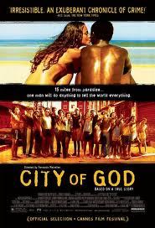

Slide 21
City of God
What does each poster suggest to you about the film?
What is the target audience of each poster?
Why do you suppose they are so different?

Slide 22
Trailers
Designed to give audiences a taste of the film. They are meant to have maximum impact.
Films trailed in cinema are often the same genre as the main feature, targeting the audience more precisely – they offer the audience something similar to what they have already paid to watch.

Slide 23
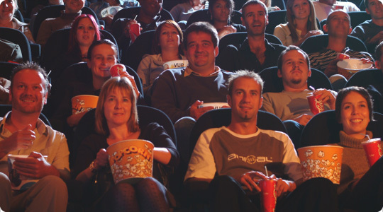
Unlike TV trailers, cinema trailers have a captive audience (people who are unlikely to stop consuming a media text).

Slide 24
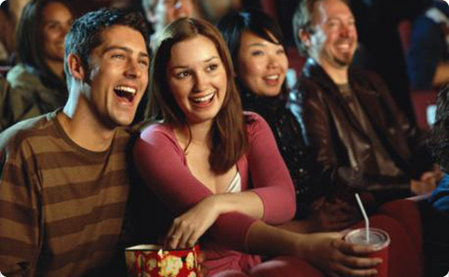
Trailers are made by specialist companies. They have certain common features in order to convey in a couple of minutes a message that people will remember.

Slide 25
Trailer Codes
Show the best bits of the film.
Action codes – use one action to indicate what is going to happen: a character is seen taking a suitcase down, so the audience knows they are going on a journey.
Enigma codes – set the scene while giving very little away: a hand is seen writing a threatening letter. Audience left to guess who it was, etc.
Leave the audience guessing, so that they feel they must watch the film.

Slide 26
Watch the following trailers, taking notes on their features. Use the table provided to you to record your responses.
Thriller
Action
Animated
Comedy
Documentary
Romance

