Slide 1
Creative Media
Lesson 2

Slide 2
Lesson Objective
At the end of this lesson we will know the Key Concepts for Media Studies, and have a solid understanding of denoting and connoting.

Slide 3
The Key Concepts
The following Key Concepts will be the basis of the subject content of the course:
Media Language: forms and convention
Audience
Institutions
Representations
MAIR

Slide 4
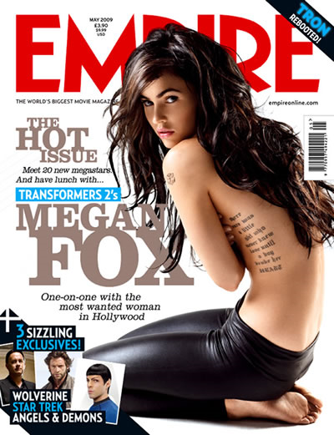


Mair works across various media types, from television, films, the internet and magazines.

Slide 5
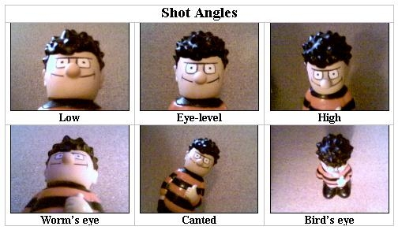
Media Language
The ways in which media texts communicate with people that use them. We will study camera movement, editing, and so on.

Slide 6

Audience
A look at how people receive media texts. We will look at how specific audiences are targeted by media companies.

Slide 7

Institution
A study of the people who own and make the media texts, and what they stand to gain.

Slide 8

Representation
A study of how various people are represented by the media. This will allow you to critically view how people are presented in television and films.

Slide 9
Today, we are going to focus on Media Language

Slide 10
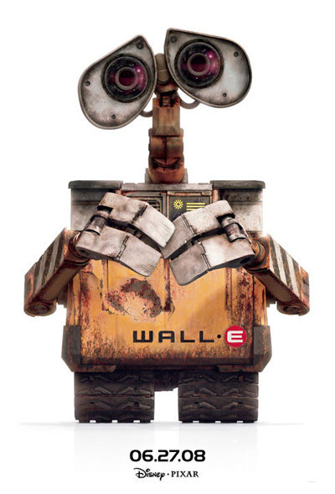
Media Language
Mise-en-scene
Means “put in scene”
The idea is that everything is in the scene for a reason.
This includes props, lighting, music, setting, characters

Slide 11
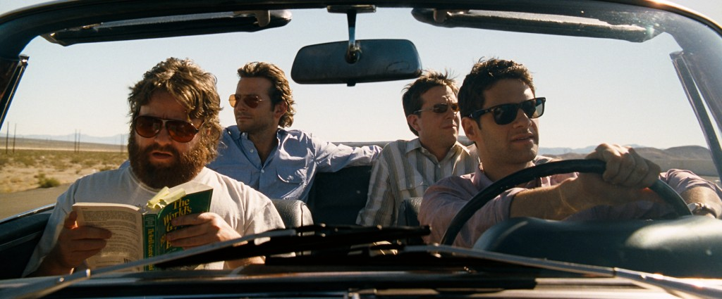
Mise- en-scene
Things to consider:
1) setting and props used
2) Costume and make-up used
3) Actors – their expression and movement
4) Lighting and use of colour
5) The way objects and people are positioned.

Slide 12
Mise en Scene
Signifiers and Symbols:
  Verbal (seen) or an aural (heard) SIGN that an audience places a meaning onto: for example, a dove could mean peace, a creaky noise or a scream could create fear, a heart shape could signify love, etc.

Slide 13
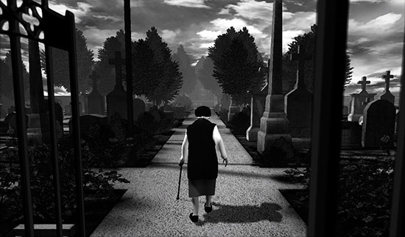
Task
Create a list with the denotations and connotations of this image. Once you’ve completed your list, write a paragraph explaining the meaning behind the image.

Slide 14
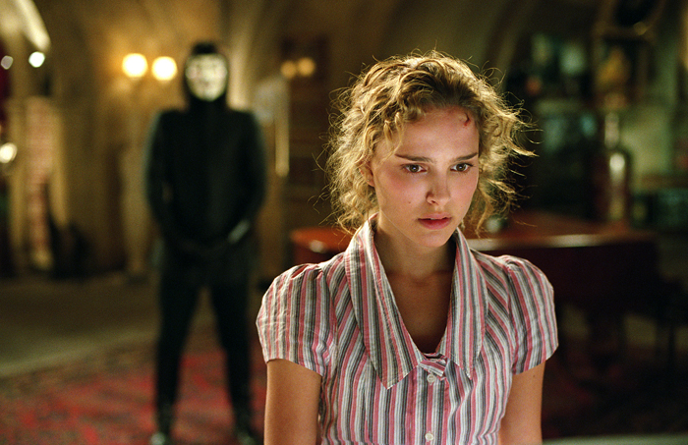
Task
Create a list with the denotations and connotations of this image. Once you’ve completed your list, write a paragraph explaining the meaning behind the image.

Slide 15
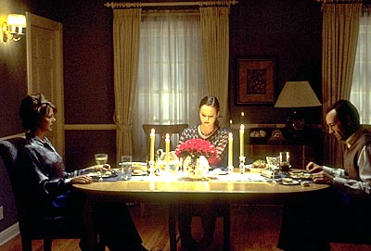
Task
Create a list with the denotations and connotations of this image. Once you’ve completed your list, write a paragraph explaining the meaning behind the image.

Slide 16
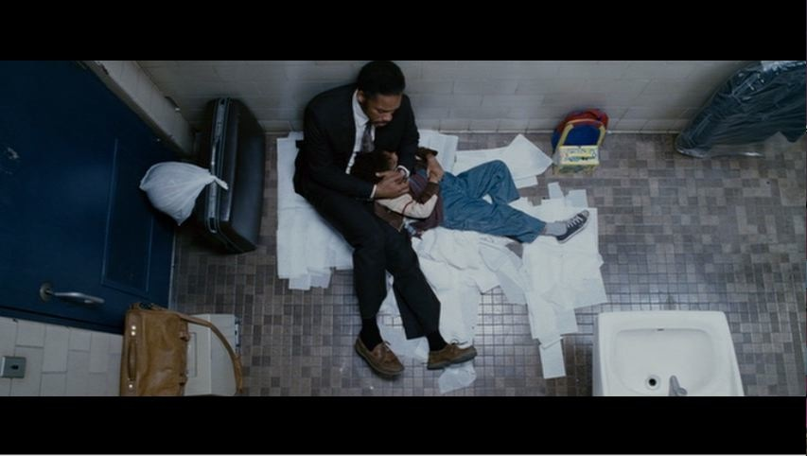
Task
Create a list with the denotations and connotations of this image. Once you’ve completed your list, write a paragraph explaining the meaning behind the image.

