Slide 1
Creative Media
Unit 1 Lesson 4

Slide 2
Lesson Objective
At the end of this lesson we will have labelled various film shots and angles.

Slide 3
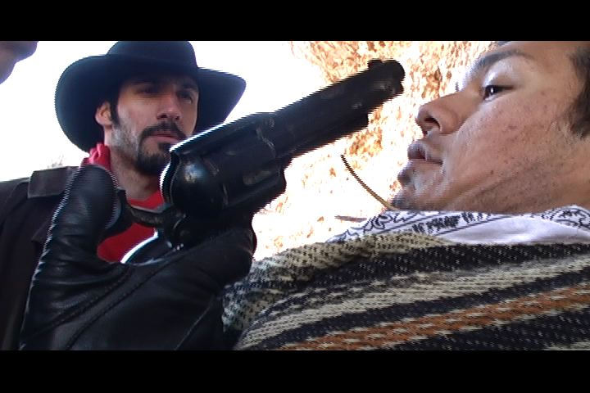
Starter
What does this shot type connotate and denotate?

Slide 4
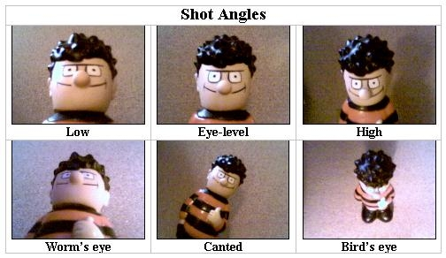
Camera shots and angles
In this course it is very important that you learn to analyse how shots have been composed in film or print media.

Slide 5
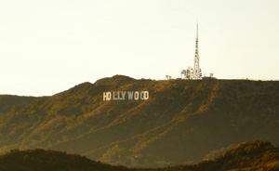
Media Language: Camera Shots
Extreme Long Shot (ELS)
Used in scene-setting, establishing shots.
They normally show an exterior
meant to give a general impression rather than specific information.
Establishing shot (ES)

Slide 6
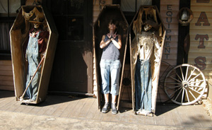
Media Language: Camera Shots
Shows the image as approximately "life" size (corresponding to the real distance between the audience and the screen in a cinema).
Includes the full shot showing the entire human body, with the head near the top of the frame and the feet near the bottom.
Long Shot (LS)

Slide 7
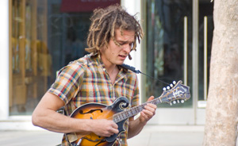
Media Language: Camera Shots
Shows a figure from the knees/waist up and is normally used for dialogue scenes, or to show some detail of action.
Backgroud detail is minimal.
Medium or Mid Shot (MS)

Slide 8
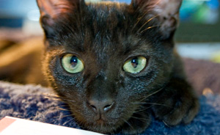
Media Language: Camera Shots
Shows very little background, and concentrates on either a face, or a specific detail of mise en scène.
Everything else is just a blur in the background.
This shot magnifies the object and shows the importance of things, be it words written on paper, or the expression on someone's face.
Close-Up (CU)

Slide 9
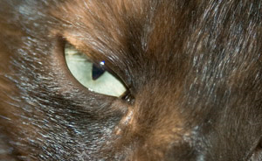
Media Language: Camera Shots
An extreme version of the close up, generally magnifying beyond what the human eye would experience in reality.
An extreme close-up of a face, for instance, would show only the mouth or eyes, with no background detail whatsoever.
This is a very artificial shot, and can be used for dramatic effect.
Extreme Close-up (ECU)

Slide 10
Media Language: Camera Shots
Over-the-shoulder shot

Slide 11
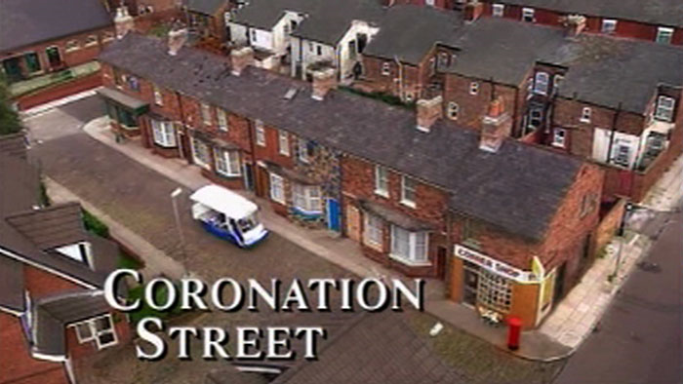
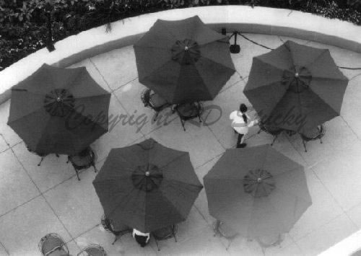
Media Language: Camera Angles
High angle
The camera is directly above the action.
Bird’s eye view
The camera is above the action, looking down at it.

Slide 12
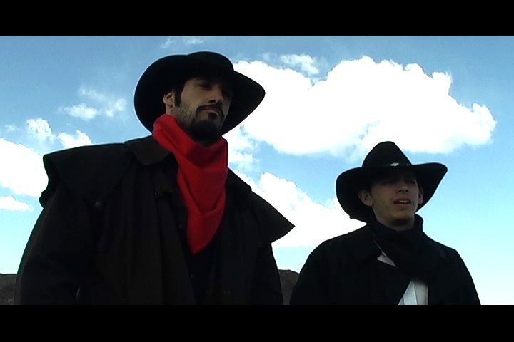
Media Language: Camera Angles
Eye-level
The camera is below the action, looking up at it.
Low angle

Slide 13
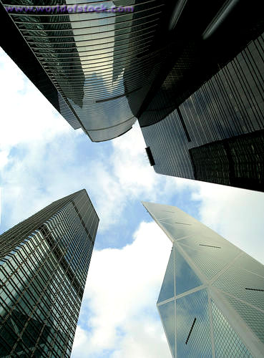
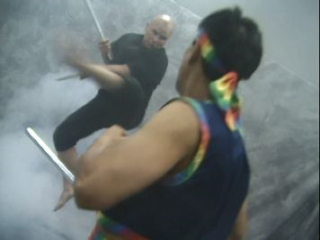
Media Language: Camera Angles
Oblique/Canted angle
Worms Eye View
The camera is directly below the action.

Slide 14
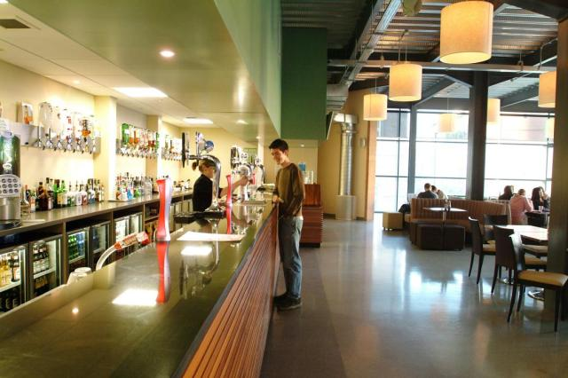
Long Shot
Establishing Shot
Crop this so it is a Medium or Mid Shot
Crop this so it is a Close-Up
Crop this so it is a an Extreme Close-Up

Slide 15
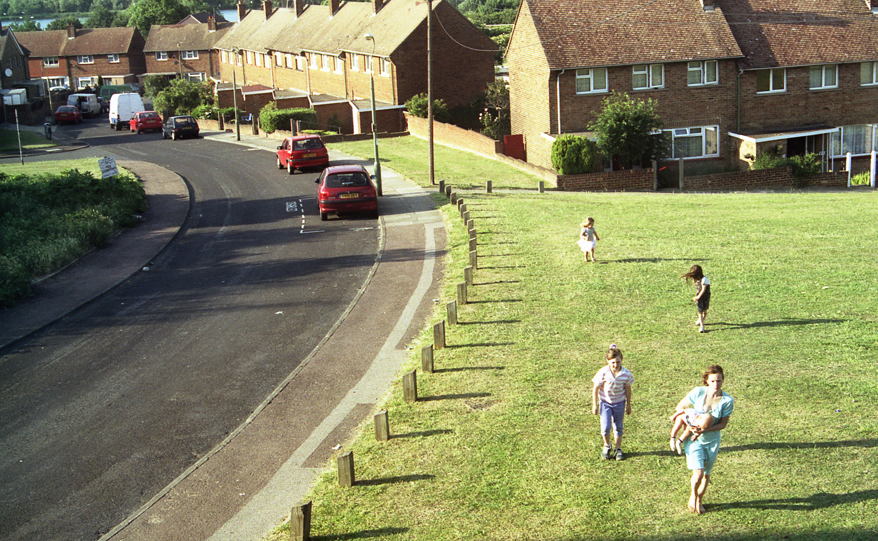
Using and the ‘Insert’ tab at the top, draw and label each shot type (ES, LS, CU, ECU) for the following pictures in the same way as modelled earlier in the lesson.

Slide 16
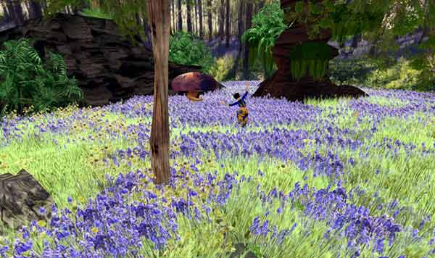
Using and the ‘Insert’ tab at the top, draw and label each shot type (ES, LS, CP, ECU) for the following pictures in the same way as modelled earlier in the lesson.

Slide 17
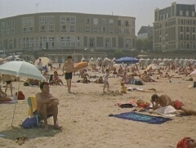
Using and the ‘Insert’ tab at the top, draw and label each shot type (ES, LS, CP, ECU) for the following pictures in the same way as modelled earlier in the lesson.

Slide 18
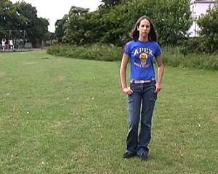
Using and the ‘Insert’ tab at the top, draw and label each shot type (ES, LS, CP, ECU) for the following pictures in the same way as modelled earlier in the lesson.

Slide 19
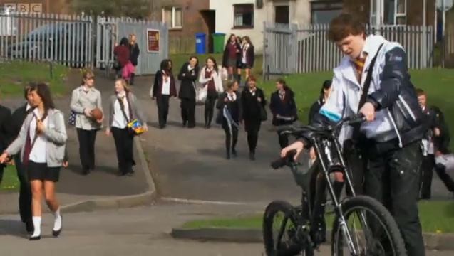
Using and the ‘Insert’ tab at the top, draw and label each shot type (ES, LS, CP, ECU) for the following pictures in the same way as modelled earlier in the lesson.

Slide 20
Plenary
QUIZ! Can you explain each of the following 5 shots?

Slide 21
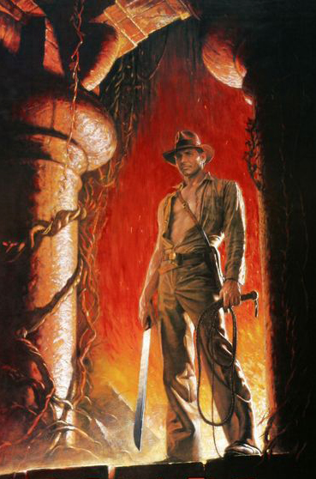
1

Slide 22
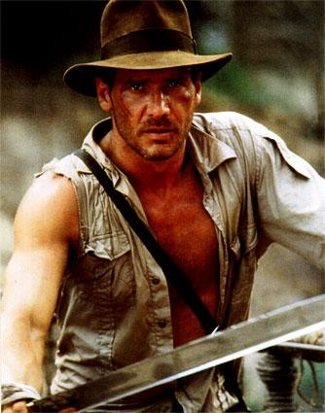
2

Slide 23
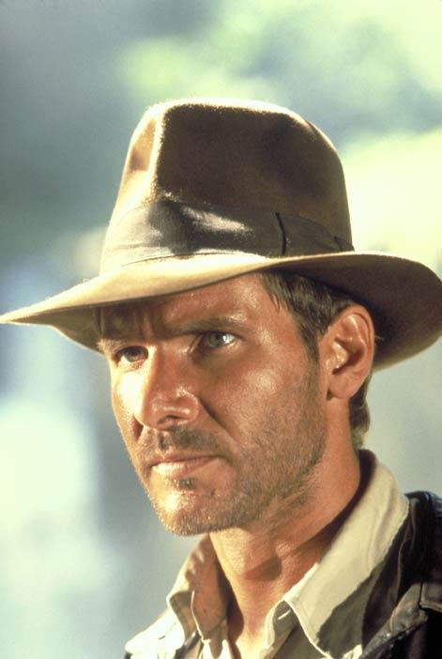
3

Slide 24
4

Slide 25
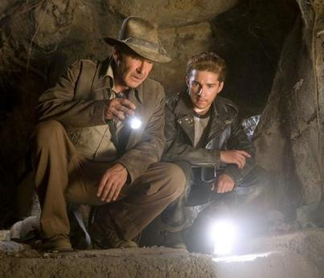
5

