Slide 1
Creative Media
Lesson 5

Slide 2
Lesson Objective
At the end of this lesson we will have analysed camera shots/angles and the effect they have on the audience.

Slide 3
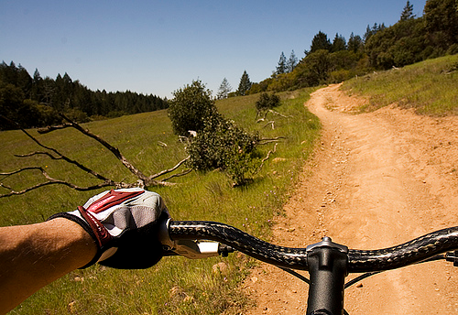
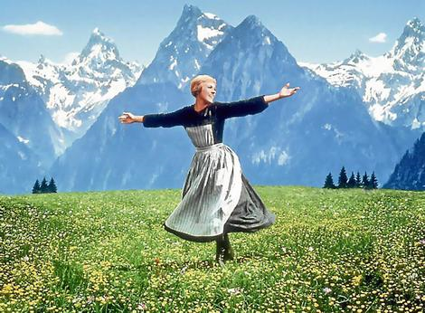
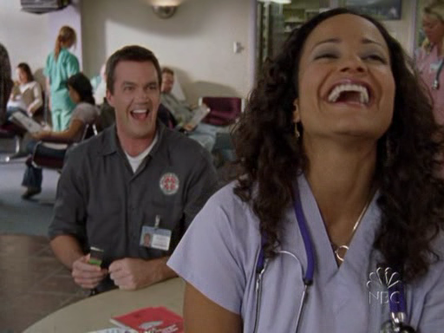
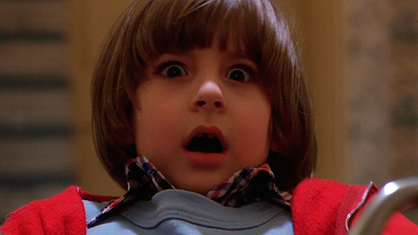
Types of Shots Starter

Slide 4
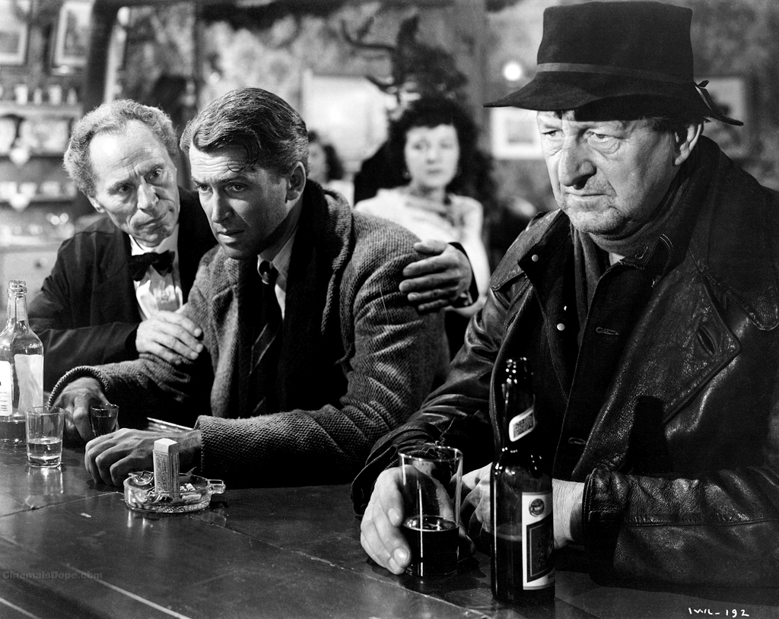
Task
Create a list with the denotations and connotations of this image. Once you’ve completed your list, write a paragraph explaining the meaning behind the image.

Slide 5
Audience positioning
Audiences enjoy texts when they feel involved in them.
We will learn to analyse the techniques used to ‘sew’ the audience into the text.
Narrative (the story)
Development ( how the story is told)

Slide 6
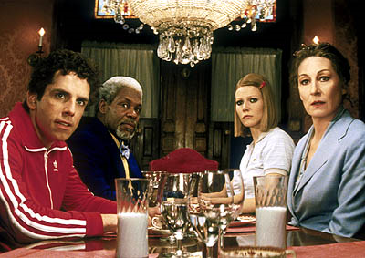
Point of View shots
Adopts the position of the character – over the shoulder or ‘in their eyes’
Audience feels they are experiencing things as well.

Slide 7
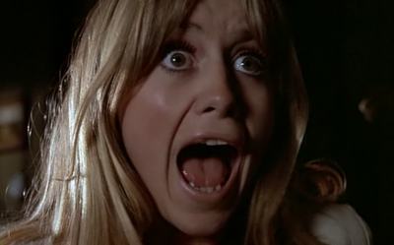
Reaction Shots
Extreme close-up of face to show reaction to something.

Slide 8
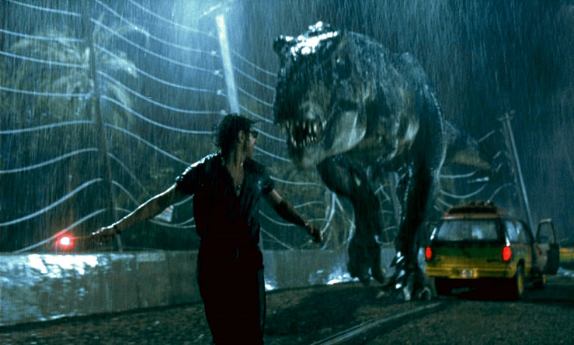
Insert shots
Gives the audience extra information that one or more characters may not know yet. The audience is aware of what is happening when some characters do not.

Slide 9
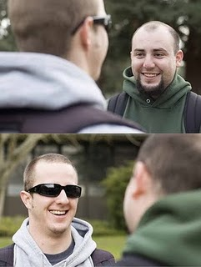
Shot reverse shot/two-shot
Camera alternates between 2 characters.
Usually as part of a conversation.
Audience feels like 3rd person in the shot.

Slide 10
Task
We will watch a series of different film clips.
Consider the shot types used
Consider the audience positioning techniques used
Comment on why you think the director chose each shot type. What was the desired effect? Do you feel this effect was achieved?

Slide 11
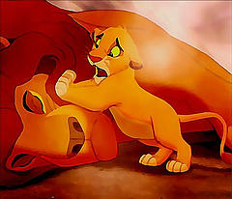
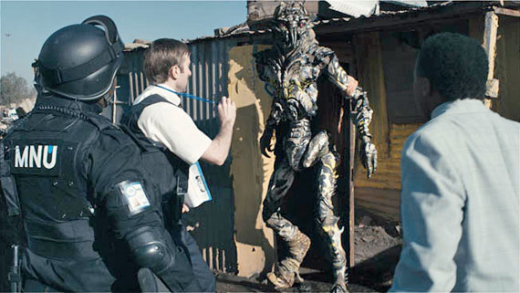
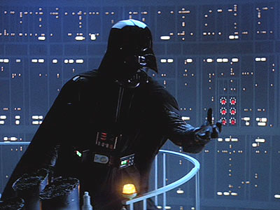
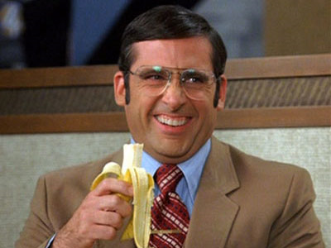
Clips

Slide 12
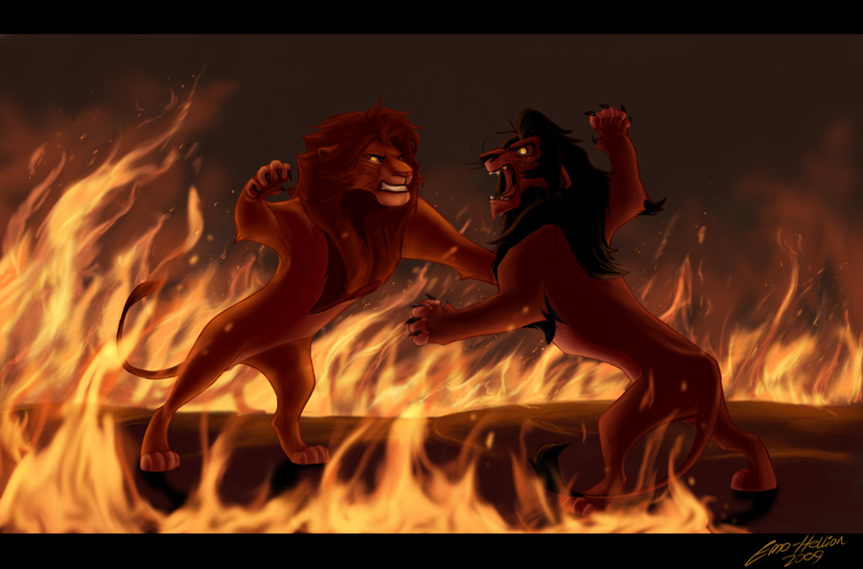
Plenary
Watch the final battle of the Lion King.
Record the information as before.
Write a brief analysis of the scene, making reference to the shot types and audience positioning techniques used, commenting on why they were used and if they were effective.

