Slide 1
Creative Media
Unit 1 Lesson 9

Slide 2
Lesson Objective
At the end of this lesson we will have produced a storyboard.

Slide 3
Quick Quiz…
What do these terms mean?
Denotation
Connotation
Genre

Slide 4
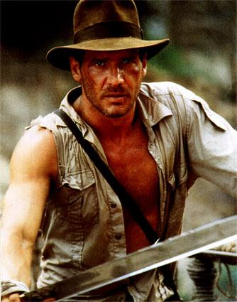
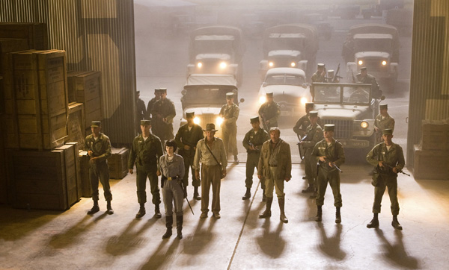
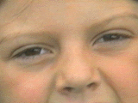
What type of shots??

Slide 5
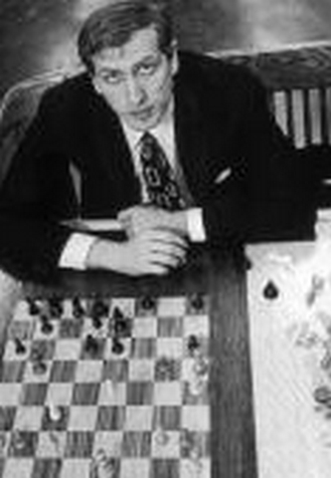
What are these two shot angles?

Slide 6
Using Our Skills
In this lesson we will be developing the skills studied over the last few lessons by putting them into practice.
Storyboarding

Slide 7
Storyboarding
Designing and drawing a storyboard is a vital part of pre-production.
Storyboards are a visual part of a film, set down on paper or computer to look like a strip of pictures (like a comic).
Alongside the pictures are notes which give details of dialogue, music, sound effects, camera movements, actor movements, etc.

Slide 8
Storyboarding
Why storyboard?
Helps you to clarify ideas and think carefully about how to get meaning across to the audience through images and pictures.
Plans the orders of your shots in a sequence.
Saves time on location (when filming), because you are prepared ahead of time.

Slide 9
Copy and complete
Scene | Shot type/angle/distance | Dialogue or Sound used
A cowboy waits for his enemy to draw his pistol in a duel.
The hero begins his journey to find an ancient sword high in the mountains.
A bomb detonates, throwing the hero of the film across the street and into a parked car.

Slide 10
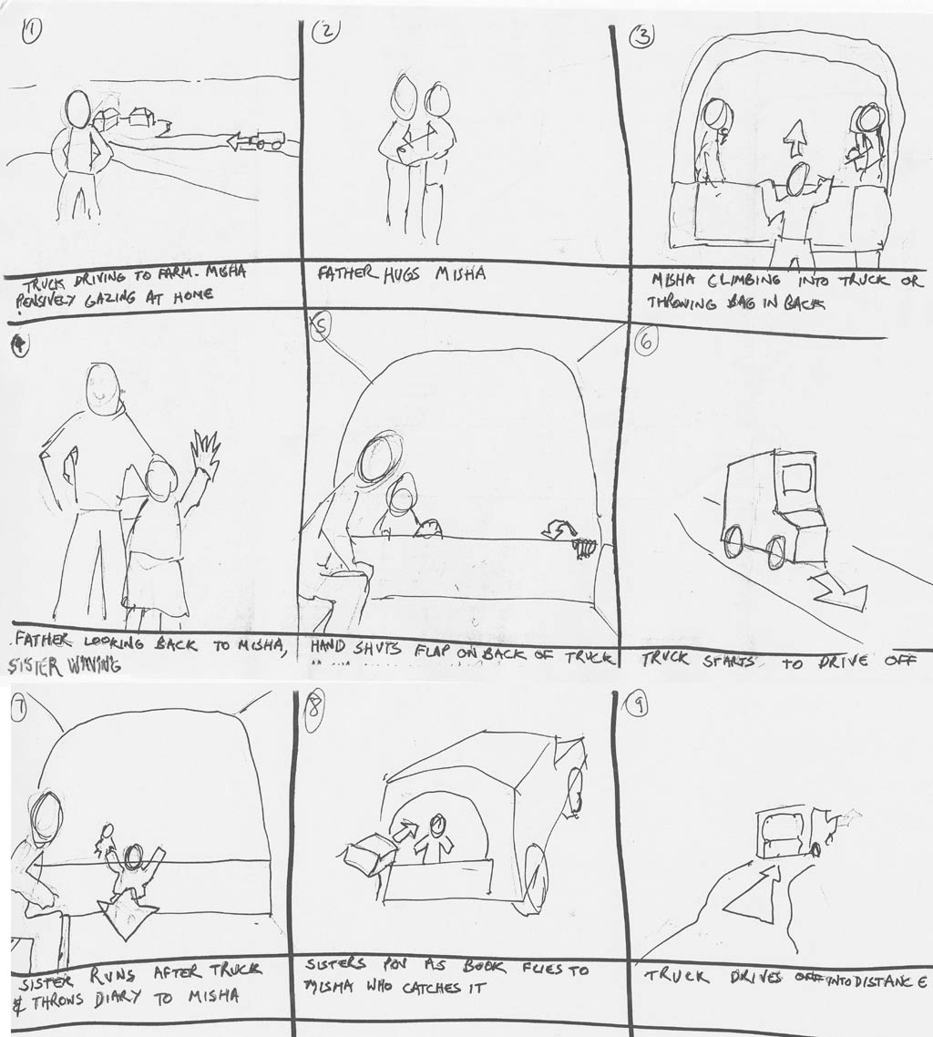
Task
Choose one of the shots described, and create a storyboard for what you have described.
You’re not being assessed on artistic ability, so don’t worry about your drawings looking good!

Slide 11
Extension Task/Homework
Now consider the script provided to you.
Create a list of 10 shots you can use to film this scene. You should not be drawing yet!
Once you’ve created a list of shots, you can begin to fill in the storyboard.

