Slide 1
Television L6

Slide 2
Lesson Objective
At the end of this lesson we will have started to create a presentation on a Media theory and our own television viewing.

Slide 3
Media Theory
There are a number of different theories as to why we use/consume media texts. These include....

Slide 4
The Effects Theory
The idea that the media can have an effect over its audience- this is often discussed in terms of negative effects.
Thought of as what the media does to its audience.

Slide 5
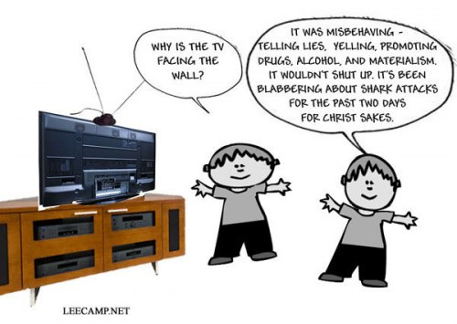
For example…
Some programs are said to create a sense of fear or panic in the general public over certain issues; The effects theory states that people watch these programs in order to gain insight, but actually they are widely influenced by what they are shown. It changes their way of thinking.

Slide 6
Hypodermic Needle Theory
The media ‘inject’ its audience with its ideas like a passive patient rather than a critical and active consumer.
The focus here is on the fact that we
don’t choose to believe certain things;
the media chooses for us.
What do you think about this
theory?

Slide 7
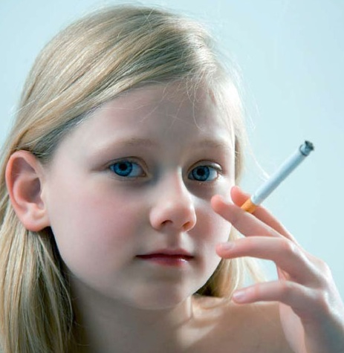
For example….
A 12 year old girl watches a teen-drama program that shows 18 year old girls obsessing about their weight, and smoking cigarettes in an attempt to be skinny.
The girl develops an obsession with her own weight, and starts to smoke cigarettes to become thinner. She also thinks the girls in the program looked pretty ‘cool’ and ‘edgy’ doing it, and wishes to be like them.

Slide 8




Uses and Gratifications Theory
The idea that media audiences make active choices about what to consume in order to meet certain needs. This is about what the audience does with the media product.
We choose what we consume, and how it will affect us.

Slide 9
4 main ways that we use media texts
Uses and Gratifications Theory
entertainment: the text provides pleasure for the audience; it is 'escapist‘ (escape reality).
social interaction: media texts are common topics of discussion; we use the media to feed this social interaction.

Slide 10
For example
Action Adventure films are some of the top-grossing films produced, simply because people enjoy watching things explode; we don’t see that every day, do we?
A woman starts a new job. She wants to fit in, and hears people talking about X-Factor in the break room on a Monday morning. She decides that next weekend she will watch X-Factor in order to take part in the conversation next week.

Slide 11
Uses and Gratifications Theory
personal identity: we can get a sense of ourselves and our peer group from the media. We may identify with particular ‘characters’, who we see as having similar life experiences
Information/education: the media are full of information which we can use

Slide 12
For example
A young man watches ‘The Inbetweeners’ because he feels like the four lads in the program depict his own group of friends perfectly.
A young working family starts to watch ‘Jamie Oliver’s 30 Minute Meals’ in order to learn how to cook delicious meals quickly.

Slide 13
Task
This is an individual task.
Choose one television program you watch on a regular basis.
Choose the Media theory that you feel best describes the reason why you consume that text.
Create a PowerPoint presentation that explains your why you consume that media text.
Aim to speak for 2 – 5 minutes.
Presentations will be given tomorrow Lesson 5.

