Slide 1
Television L9
Analysing Audience

Slide 2
Lesson Objective
At the end of this lesson we will have briefly discussed how to analyse target audience.

Slide 3
Analysing Media Audiences
There are five main methods of analysing a target audience:
By gender
By age
By social class
By psychographics
By needs

Slide 4


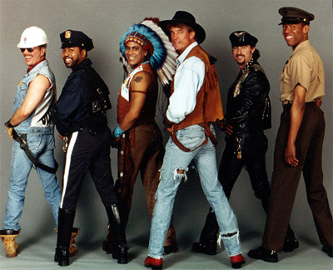
Gender:
Male
Female
LGBT

Slide 5
Age
Pre-school (5-10)
Pre-teens (10-13)
Early teens (13-14)
Late teens (14-19)
Early 20s
Late 20s
30-45
45-55
55-70
70+
Young/immature
mature

Slide 6
Social Class
A – Upper middle class – lots of disposable income
B – Middle class – a fair amount of disposable income
C1 – Lower middle class – some disposable income
C2 – Skilled working class – some disposable income
D – Working class – little disposable income
E – Lowest level of subsistence – no disposable income

Slide 7
Psychographics:
- Any attributes relating to personality, values, attitudes, interests, or lifestyles.
Also called IAO variables (for Interests, Activities, and Opinions).

Slide 8

Psychographics:
Succeders

Slide 9

Psychographics:
Aspirers

Slide 10

Psychographics:
Mainstreamers

Slide 11
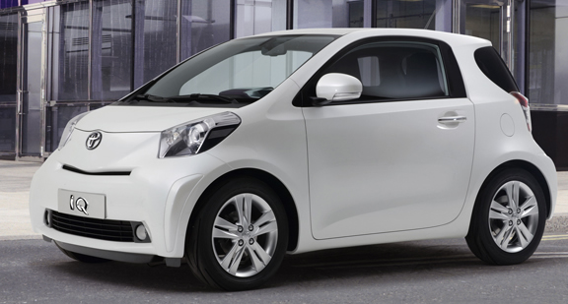
Psychographics:
Reformers

Slide 12

Psychographics:
Explorers

Slide 13
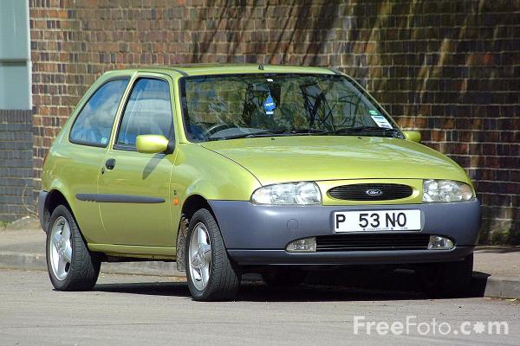
Psychographics:
Strugglers

Slide 14

Psychographics:
Resigned

Slide 15
By needs:
SEX!

Slide 16
FRIENDSHIP

Slide 17

Need to nurture

Slide 18
Need for guidance

Slide 19
Need to fight!

Slide 20
Need to dominate!

Slide 21
Need to show status!

Slide 22
Need for attention

Slide 23
Need for autonomy-
Being yourself!

Slide 24

Need to escape!

Slide 25
Need to feel safe from threats

Slide 26
Need for beauty

Slide 27
Need to satisfy curiosity

Slide 28


Physical needs: food/sleep/drink

Slide 29
Task
Consider the following title sequence.
Discuss the following question, in paragraph form:
What is the target audience of this program? Be sure to discuss gender, age and psychographics. Give clear evidence to support your statement(s).

