Slide 1
Television Openings
Coursework Part 2

Slide 2
Lesson Objective
At the end of this lesson we will have practised our storyboarding skills.

Slide 3
How to storyboard...
What element are included in a typical storyboard?

Slide 4
How to storyboard...
Elements to include
A sketch of the action should go here. NO STICK FIGURES!
Shot type and angle used Write a brief description of what takes place here.
Sound/Dialogue/Effects
Edit/Length of clip (timing)

Slide 5
Task
The following slides contain screen shots from an episode of Doctor Who.
Re-watch the sequence first.
Then fill in the ‘storyboard’ by adding text to each slide where appropriate.

Slide 6
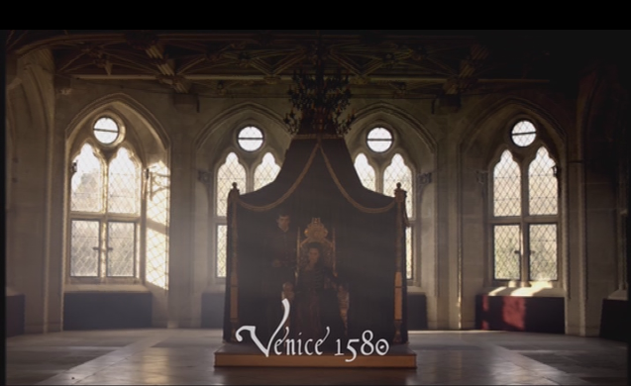
How to storyboard...
Shot type/Angles/Description
Sound/Dialogue/FX
Timing/Edits

Slide 7
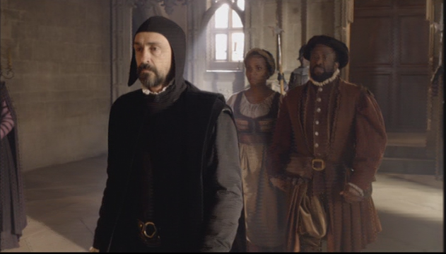
How to storyboard...
Shot type/Angles/Description
Sound/Dialogue/FX
Timing/Edits

Slide 8
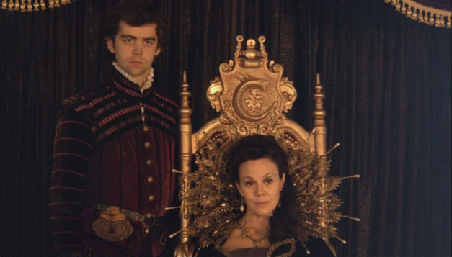
How to storyboard...
Shot type/Angles/Description
Sound/Dialogue/FX
Timing/Edits

Slide 9
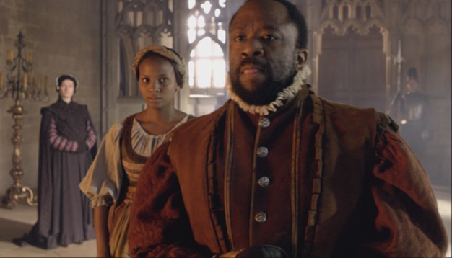
How to storyboard...
Shot type/Angles/Description
Sound/Dialogue/FX
Timing/Edits

Slide 10
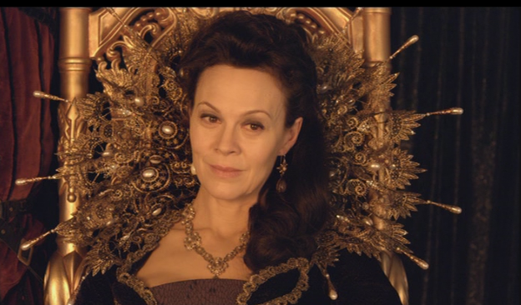
How to storyboard...
Shot type/Angles/Description
Sound/Dialogue/FX
Timing/Edits

Slide 11
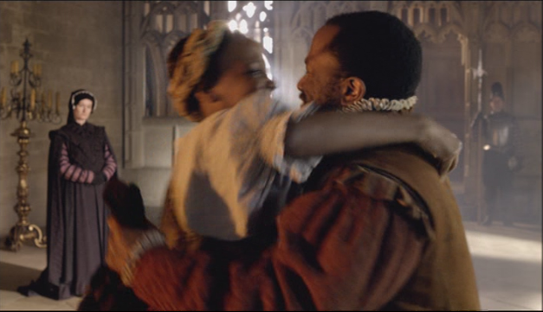
How to storyboard...
Shot type/Angles/Description
Sound/Dialogue/FX
Timing/Edits

Slide 12
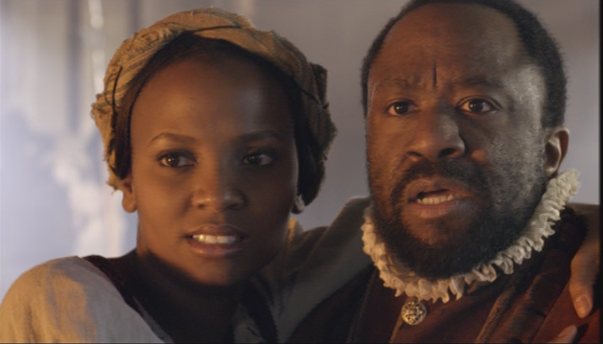
How to storyboard...
Shot type/Angles/Description
Sound/Dialogue/FX
Timing/Edits

Slide 13
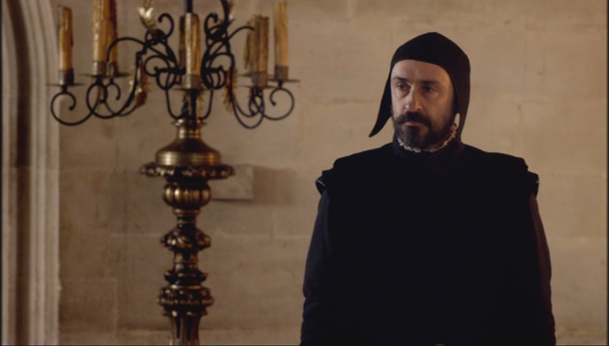
How to storyboard...
Shot type/Angles/Description
Sound/Dialogue/FX
Timing/Edits

Slide 14
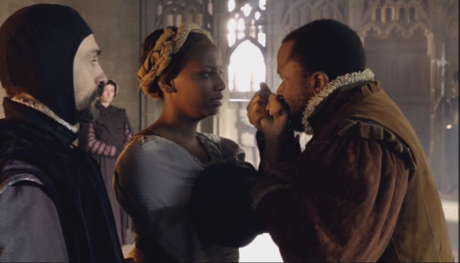
How to storyboard...
Shot type/Angles/Description
Sound/Dialogue/FX
Timing/Edits

Slide 15
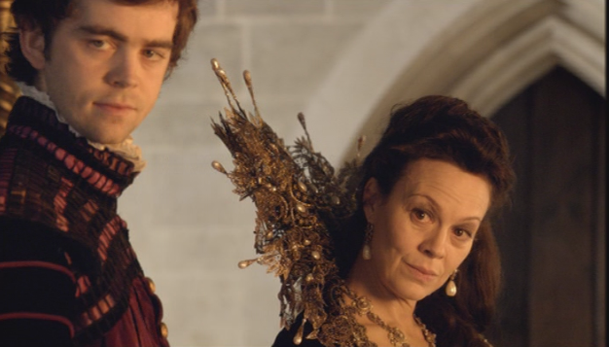
How to storyboard...
Shot type/Angles/Description
Sound/Dialogue/FX
Timing/Edits

Slide 16
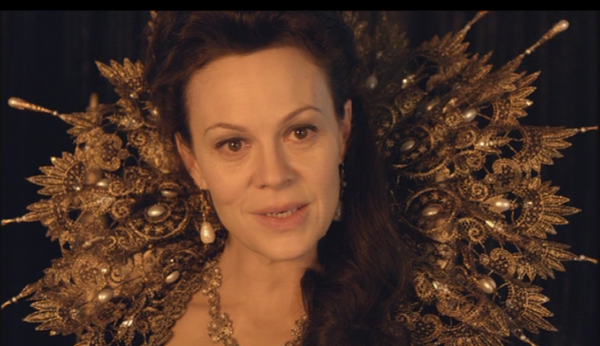
How to storyboard...
Shot type/Angles/Description
Sound/Dialogue/FX
Timing/Edits

Slide 17
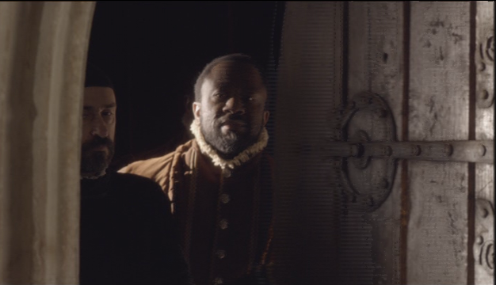
How to storyboard...
Shot type/Angles/Description
Sound/Dialogue/FX
Timing/Edits

Slide 18
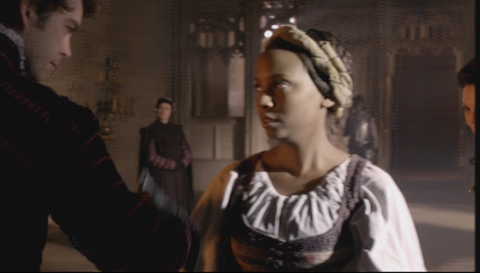
How to storyboard...
Shot type/Angles/Description
Sound/Dialogue/FX
Timing/Edits

Slide 19
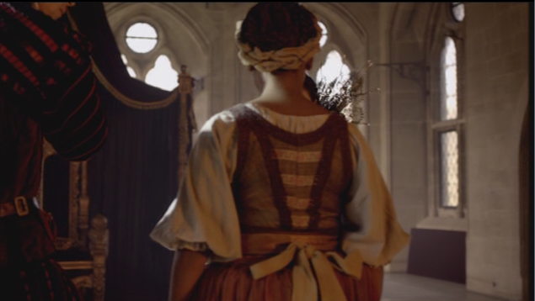
How to storyboard...
Shot type/Angles/Description
Sound/Dialogue/FX
Timing/Edits

Slide 20
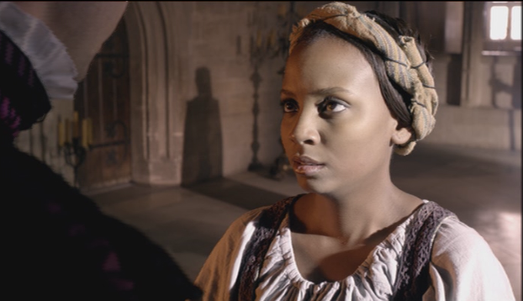
How to storyboard...
Shot type/Angles/Description
Sound/Dialogue/FX
Timing/Edits

Slide 21
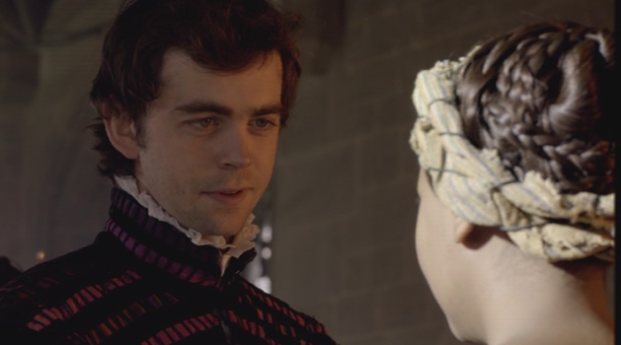
How to storyboard...
Shot type/Angles/Description
Sound/Dialogue/FX
Timing/Edits

Slide 22
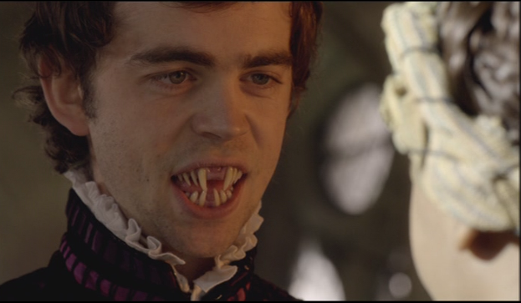
How to storyboard...
Shot type/Angles/Description
Sound/Dialogue/FX
Timing/Edits

Slide 23
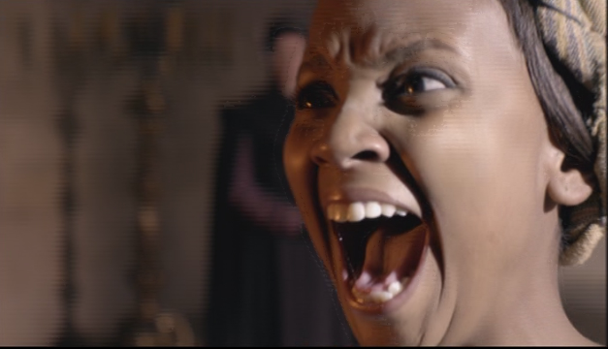
How to storyboard...
Shot type/Angles/Description
Sound/Dialogue/FX
Timing/Edits

