Slide 1
Media Studies
Unit 3 Introduction

Slide 2
Lesson Objective
At the end of this lesson we will have discussed the outcomes of this unit, and started looking at conventions employed in theatrical film trailers.

Slide 3
Starter
Watch the following trailer.
What do we learn about the film?
What genre is the film? How is this made evident?
Who is in it? How is this made evident?
What is the plot? How is this made evident?
Where does it take place? How is this made evident?
Who is the target audience? How is this made evident?

Slide 4
Unit 3: Practical Production and Evaluation
For our final unit of the year, you will be required to undertake a practical production that address all four key concepts (Media Language, Audience, Institution, and Representation).
You must work in groups of 4.
You will also have to write a 700-800 word evaluation of your production.

Slide 5
Practical Production
Your task will be to create a 120 second trailer or opening sequence for a feature film aimed at a specific audience.
It must strike a balance between creativity and the application of appropriate codes and conventions.
It must use original material wherever possible.
Each member of the group must contribute to the editing process individually.

Slide 6
You MUST create a script to be assessed as part of your practical production.

Slide 7
What you will need to do
Conduct research into existing film trailers.
Conduct research into your potential audience, using analysis of existing texts, charts, surveys, or questionnaires.
All evidence of planning should be kept and submitted, including briefs, sketches, storyboards, scripts, drafts, etc.

Slide 8
Specific Areas of Focus
To get a good grade, you should show confidence in handling technology by demonstrating:
Careful framing of shots
Editing appropriate to the nature of the production and audience
Evidence of consideration being given to lighting, mise-en-scene and sound.
The use of narration, titles, narrative clues and a selection of fast cuts of different scenes.

Slide 9
Written Evaluation
Each member of the group must have a specific role/task to complete, and it must be clearly indicated in the written evaluation.
Each member must submit their own individual evidence of research and planning in the written evaluation.

Slide 10
Written Evaluation
You should reflect on:
How the aims of the production have been met
How the product applies appropriate codes and conventions and uses appropriate media language
How the product represents people, places or events
Where and when the product would be exhibited
What regulations and controls might be applied to the product and how these have been taken into consideration
The strengths and weaknesses of the product in terms of meeting the needs of its audience.

Slide 11
How we will prepare
Watch a wide variety of film trailers, taking notes on mise-en-scene, codes and conventions used re: genre, audience appeal, representation and institution.
Consider the use of lighting, camera movement, focus, angle, edits, sound effects and special effects in film trailers.
Create and use questionnaires to help us determine audience needs.
Practice using video cameras and editing software.
Create and plan scripts.

Slide 12
Film Trailers
A trailer or preview is an advertisement for a feature film that will be exhibited in the future at a cinema.
The term "trailer" comes from their having originally been shown at the end of a feature film screening.
Trailers are now shown before the feature film.
Movie trailers have also become popular on the Internet. Of some 10-billion videos watched online annually, movie trailers rank #3, after news and user-created video

Slide 13
Film Trailers
A benefit of film trailers are that they are shown to a captive audience – one that is unlikely to stop consuming the text.
People have paid to see a certain type of film, so they watch the trailers as they wait for the feature to begin.
Films trailed are often of a similar genre to the main feature, targeting the audience more precisely.

Slide 14
Film Trailers
The purpose of the trailer is to attract an audience to the film.
They use the most exciting, funny, or otherwise noteworthy parts of the film, but in short, accessible form, usually without producing spoilers.
The scenes are not necessarily in the order in which they appear in the film.
Trailers are limited to two and a half minutes, the maximum length allowed by the Motion Picture Association of America. Each studio or distributor is allowed to exceed this time limit once a year, if they feel it is necessary for a particular film.

Slide 15
As well as using genre to gain our interest, marketing campaigns must also show us how a new film is different to others in the same genre: this is known as the USP (unique selling point) of the film.

Slide 16
The USP is what separates one film title from another released at a similar time or within the same genre. The USP could be many things, for example:
the innovative use of special effects
an unusual mix of genre
popular characters

Slide 17
Watch each of the five trailers listed below, stating what you think is its USP.
FILM | USP
Captain America
Cowboys & Aliens
Super 8
Reel Steel
Senna
Use the filmeducation DVD to access these trailers

Slide 18
Codes for Quick Information
Action Codes – use one action to indicate what is going to happen: a character is seen taking down a suitcase, so you know they are going to go on a journey.
Enigma Codes – set the scene while giving very little away: A hand is seen writing a threatening letter; who is writing the letter? Why?

Slide 19
The key is to leave the audience with a question, or a desire for knowledge, that can only be answered by seeing the film.

Slide 20
Some trailers use "special shoot" footage, which is material that has been created specifically for advertising purposes and does not appear in the actual film. The most notable film to use this technique was Terminator 2: Judgment Day, whose trailer featured elaborate special effects scenes that were never intended to be in the film itself

Slide 21
There are dozens of companies that specialize in the creation of movie trailers in Los Angeles and New York. The trailer may be created at agencies (such as The Cimarron Group, MOJO, The Ant Farm, Aspect Ratio, Flyer Entertainment, Trailer Park) while the movie itself is being cut together at the studio.

Slide 22
Since the edited movie does not exist at this point, the trailer editor work from rushes or dailies. Thus, the trailer may contain footage that is not in the final movie, or the trailer editor and the movie editor may use different takes of a particular shot

Slide 23
Another common technique is including music on the trailer which does not appear on the movie's soundtrack. This is nearly always a requirement, as trailers and teasers are created long before the composer has even been hired for the film score—sometimes as much as a year ahead of the movie's release date—while composers are usually the last creative people to work on the film.

Slide 24
Trailers have become highly polished pieces of advertising, able to present even poor movies in an attractive light.

Slide 25
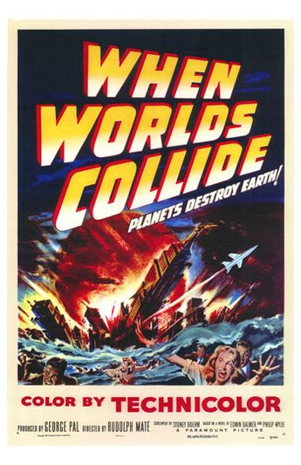
History of Film Trailers
Up until the late 1950s, trailers were mostly created by the National Screen Service and consisted of various key scenes from the film, often augmented with large, descriptive text describing the story, and an underscore generally pulled from studio music libraries. Most trailers had some form of narration.

Slide 26
In the early 1960s, the face of motion picture trailers changed. Text-less, montage trailers and quick-editing became popular, largely due to the arrival of the "new Hollywood" and techniques that were becoming increasingly popular in television.

Slide 27
In 1964, Andrew J. Kuehn distributed his independently-produced trailer for Night of the Iguana, using stark, high-contrast photography, fast-paced editing and a provocative narration by a young James Earl Jones (the voice of Darth Vader).
His format was very successful.

Slide 28
As Hollywood began to produce bigger blockbuster films and invest more money in marketing them, directors like Steven Spielberg began to depend on Kuehn and Kaleidoscope for their ability to create the best trailers theatre-goers could see.

Slide 29
Today, longer, more elaborate trailers and commercial advertisements have replaced other forms of pre-feature entertainment and in major multiplex chains, about the first twenty minutes after the posted showtime is devoted to trailers.

Slide 30
Codes and Conventions
Most trailers have a three-act structure similar to a feature-length film.
They start with a beginning (Act 1) that lays out the premise of the story.

Slide 31
The middle (Act 2) drives the story further and usually ends with a dramatic climax.

Slide 32
Act 3 usually features a strong piece of "signature music" (either a recognizable song or a powerful, sweeping orchestral piece). This last act often consists of a visual montage of powerful and emotional moments of the film and may also contain a cast run if there are noteworthy stars that could help sell the movie.

Slide 33
Watch the following trailer, taking note on how it follows the 3 Act Structure.

Slide 34
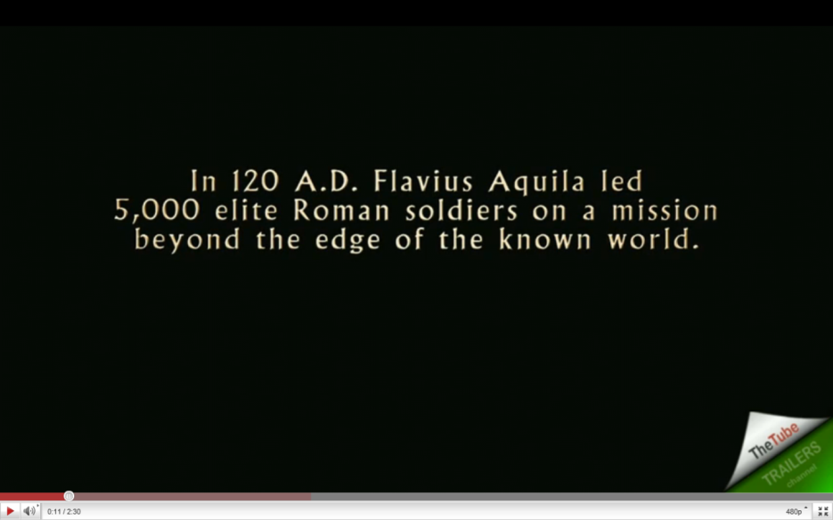
Codes and Conventions
Act 1: Voice-over narration/textual information is used to briefly set up the premise of the movie and provide explanation when necessary ("In a world..."). Since the trailer is a highly condensed format, voice-over is a useful tool to enhance the audience's understanding of the plot.

Slide 35
Codes and Conventions
Music helps set the tone and mood of the trailer. Usually the music used in the trailer is not from the film itself. The music used in the trailer may be:
Music from the score of other movies.
Popular or well known music, often chosen for its tone, appropriateness of a lyric or lack thereof, or recognisability.
"Library" music previously composed specifically to be used in advertising by an independent composer.
Specially composed music.

Slide 36
A cast run is a list of the stars that appear in the movie. If the director or producer is well-known or has made other popular movies, they often warrant a mention as well.

Slide 39
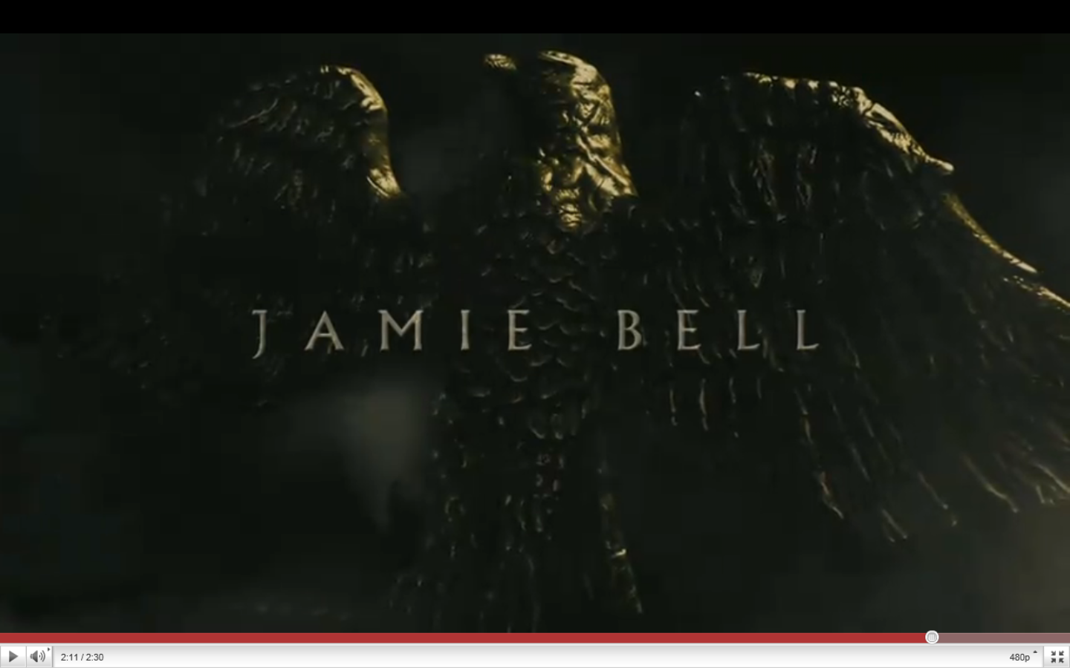

Slide 40
Most trailers conclude with a billing block, which is a list of the principal cast and crew. It is the same list that appears on posters and print publicity materials, and also usually appears on-screen at the beginning (or end) of the movie.

Slide 42
Studio production logos are usually featured near the beginning of the trailer. Until the late 1970s, they were put only at the end of the trailer. Often there will be logos for both the production company and distributor of the film.

Slide 44
Plenary Task
Watch the following trailers, taking note on how each follows the 3 Act Structure.
Trailer 1
Trailer 2
Trailer 3

Slide 45
Extended Plenary
Using YouTube, or Apple’s Film Website, watch a few film trailers of your choice, taking notes on how the trailers follow the 3 Act Structure. You can also note any other conventions that the trailer employs.

