Slide 1
Learning Objective:
To understand and explore the term ‘mise-en-scene’.

Slide 2
YOUR TASK
V:> Media Studies > Miss Carson > Film Unit > Unit 3 L3
Work through the Powerpoint, copying the information from slides 3,4,5, 9,10, 21,22 and 23 into your workbooks.
Complete all the tasks as described on the remaining slides. Write in full sentences, and using sufficient detail/explanation.

Slide 3
Definition: Mise En Scene
A French term meaning what is put into a scene or frame
Visual information in front of the camera
Communicates essential information to the audience
Made up of 5 elements: Can you guess what they are?

Slide 4
The 5 Elements of Mise en Scene
Each aspect of mise-en-scene has hidden meanings within a film and sends signals to the audience about how we are supposed to feel at a certain point
Settings & Props
Costume, Hair & Make Up
Facial Expressions & Body Language
Lighting & Colour
Positioning of characters/objects within the frame

Slide 5
1. Settings & Props
Settings & Locations play an important part in film-making and are not just ‘backgrounds’
Sets are either built from scratch or a great deal of time is spent to find a setting which already exists
Settings can manipulate an audience by building certain expectations and then taking a different turn

Slide 6
Task 1
Using Google image search, find a selection of five images that represent 5 different types of settings/props you’d expect to find in each of the following genres:
A Science Fiction Film

Slide 7
Using Google image search, find a selection of five images that represent 5 different types of settings/props you’d expect to find in each of the following genres:
A Romantic Comedy

Slide 8
Using Google image search, find a selection of five images that represent 5 different types of settings/props you’d expect to find in each of the following genres:
A Horror Film

Slide 9
2. Costume, Hair & Make Up
Costume, Hair & Make Up act as an instant indicator to us of a character’s personality, status & job
It tells us immediately whether the film is set in the present and what society/or culture it will centre around
Certain costumes can signify certain individuals (i.e. black cloak of a vampire, Spidey’s Spiderman suit)

Slide 10
3. Facial Expressions & Body Language
Facial Expressions provide a clear indicator of how someone is feeling
If someone is smiling broadly, we assume they are happy but we may get a different feeling if this is accompanied by scary music
Body Language may also indicate how a character feels towards another character or may reflect the state of their relationship

Slide 11
TASK: What meanings/emotions do the following images convey:
Write a blurb on the slide that follows, explaining the meanings/emotions shown in each slide. Be sure to comment on HOW you know this!

Slide 12
IMAGE 1

Slide 13
Explanation of Image 1
Type here

Slide 14
IMAGE 2

Slide 15
Explanation of Image 2
Type here

Slide 16
4. Positioning of Characters & Objects within a frame
Positioning within a frame can draw our attention to an important character/object
A film-maker can use positioning to indicate relationships between people

Slide 17
What does the positioning in the following images reveal about the characters/film:
Write your responses on the slides that follow.

Slide 18
IMAGE 1

Slide 19
Explanation of Image 1
Type here

Slide 20
IMAGE 2

Slide 21
Explanation of Image 2
Type here

Slide 22
5. Lighting & Colour
Lighting & Colour can be used to achieve a variety of effects:
To highlight important characters or objects within the frame
To make characters look mysterious by shading sections of the face & body
To reflect a characters mental state/hidden emotions (i.e. bright = happy, dark = disturbed, strobe effect = confused

Slide 23
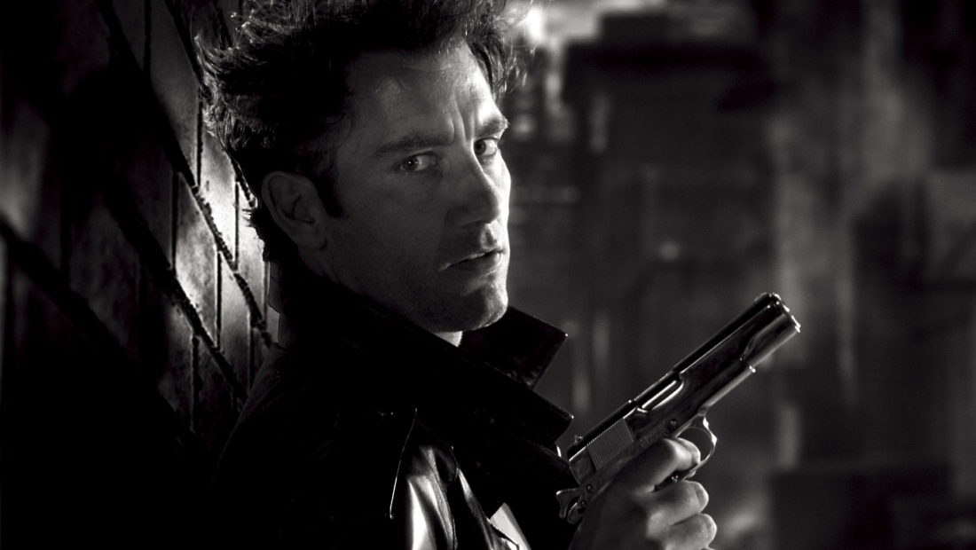
Types of Lighting
LOW KEY LIGHTING:
Created by using only the key & back lights
Produces sharp contrasts of light and dark areas
Deep, distinct shadows/silhouettes are formed
Example: Horror Films

Slide 24
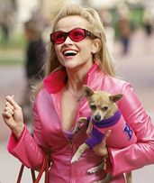
Types of Lighting
HIGH KEY LIGHTING:
More filler lights are used. Lighting is natural and realistic to our eyes
Produces brightly lit sets or a sunny day (right)
Example: Rom-Coms

Slide 25
Look at the next screen shot: an establishing shot.
What does the mise-en-scene tell you about the location?
Think about:
Lighting
Location
Colour
Props

Slide 26
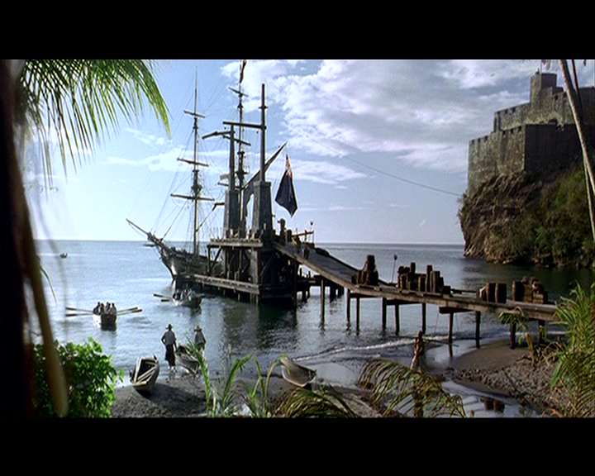

Slide 27
Lots of blue colour:
Connotations of sea, calm, cool
Props: all adding to the nautical/sea theme of the film
The sea: Caribbean location, pirates
Lighting: natural and bright, so tranquil and happy mood in the scene

Slide 28
Type your response to the image here

Slide 29
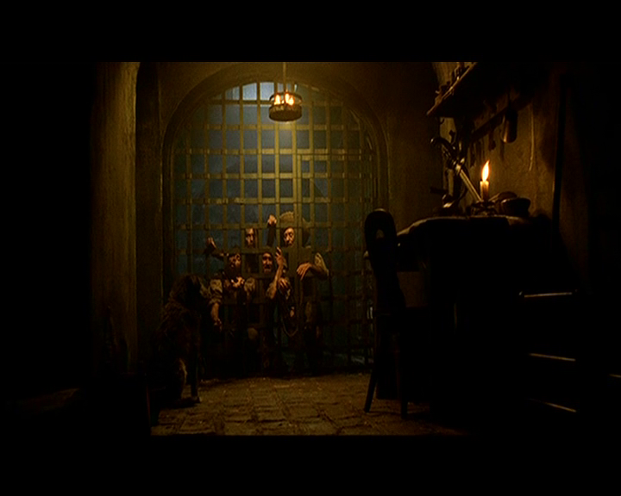
Lighting and set

Slide 30
Type response here

Slide 31
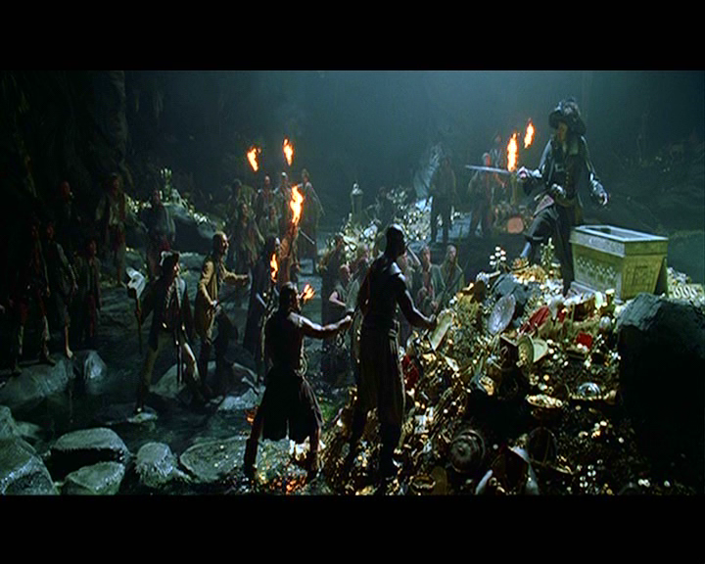
Props and costume

Slide 32
Type response here

Slide 33
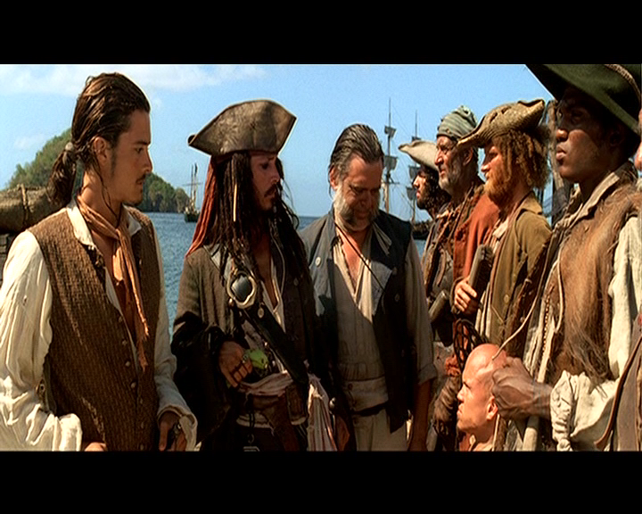
Costume and expression

Slide 34
Type response here

