Slide 1
Media Studies
Unit 3: Filming

Slide 2
Lesson Objective
At the end of this lesson we will have used video cameras to practice filming using various camera angles and techniques.

Slide 3
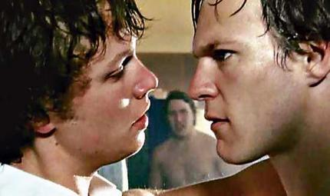
Film Shots/Angles
What type of shot is being used here, and how does it effective portray meaning?

Slide 4
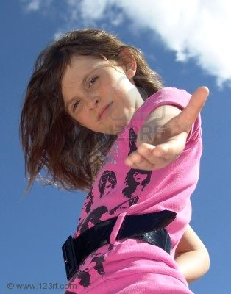
Film Shots/Angles
What type of shot is being used here, and how does it effective portray meaning?

Slide 5
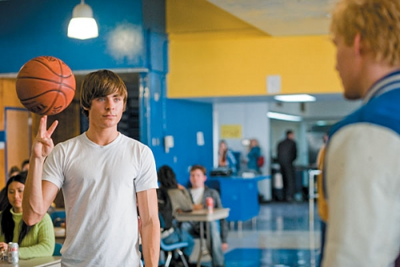
Film Shots/Angles
What type of shot is being used here, and how does it effective portray meaning?

Slide 6
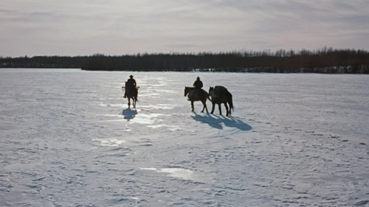
Film Shots/Angles
What type of shot is being used here, and how does it effective portray meaning?

Slide 7
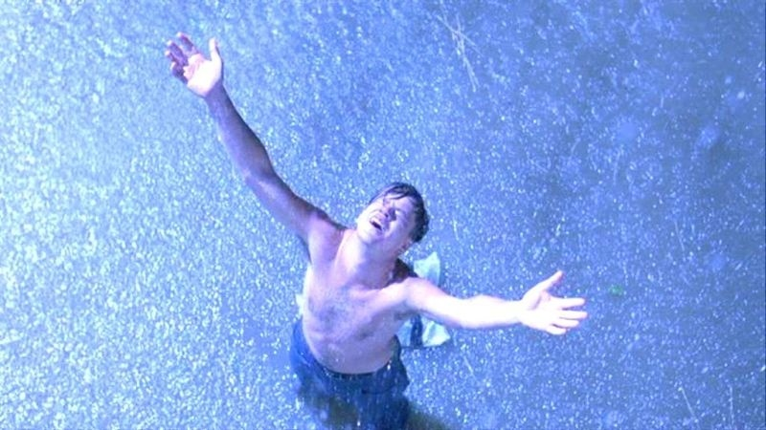
Film Shots/Angles
What type of shot is being used here, and how does it effective portray meaning?

Slide 8
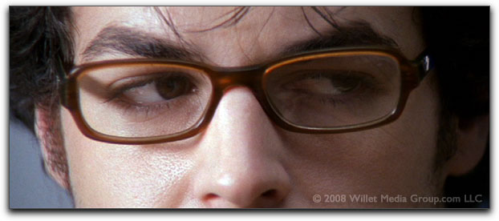
Film Shots/Angles
What type of shot is being used here, and how does it effective portray meaning?

Slide 9
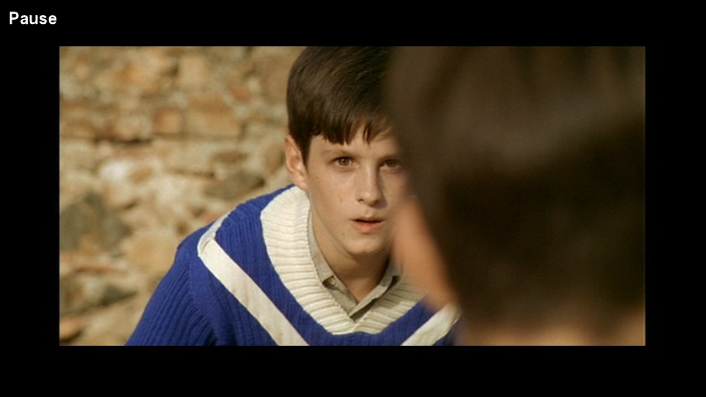
Film Shots/Angles
What type of shot is being used here, and how does it effective portray meaning?

Slide 10
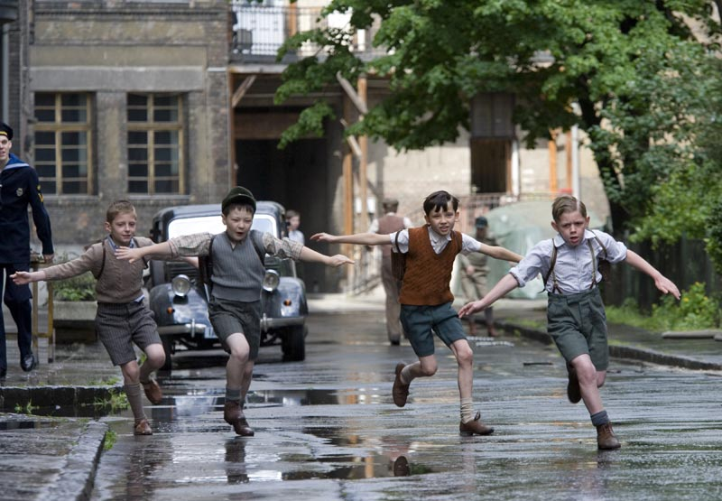
Film Shots/Angles
What type of shot is being used here, and how does it effective portray meaning?

Slide 11
TASK
When filming, it is important to carefully frame each shot. How you choose to set up each shot can drastically affect meaning.
In groups, and using the worksheet provided, try to film each of the four scenarios, using careful shot selection.

Slide 12
Plenary
Each group will edit their clips, and present them to the class.
We will vote on who managed to most effectively film each of the four scenarios, and award prizes to the winners.

