Slide 1
Advertising Across Platforms
Lesson 5

Slide 2
Lesson Objective
At the end of this lesson we will understand the basic ways television advertising works.

Slide 3
Starter
Think of three advertisements that you have enjoyed on the television recently.
Why did you like them?
What sort of products did they advertise?
Did they persuade you to buy the product?

Slide 4
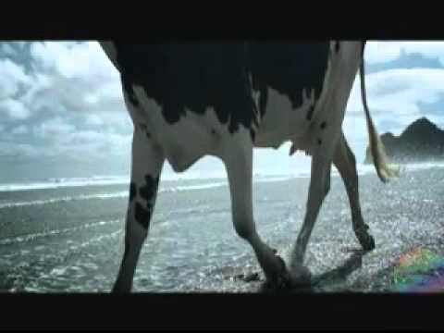
My favourite advert….

Slide 5
Advertisements are expensive.
They are well placed to ensure people who watch will buy.
Advertisers must consider:
Time of day
Program being shown
Target audience

Slide 6
For example, what type of ads would you expect to see….
During a Countdown program on Channel 4 at 3:15 in the afternoon?
During a Tuesday night football match on ITV1 at 7:30pm?
During a Miami Ink episode on Discovery on a Saturday afternoon?
During the Hit40UK countdown on 4Music on a Saturday at 5pm?

Slide 7
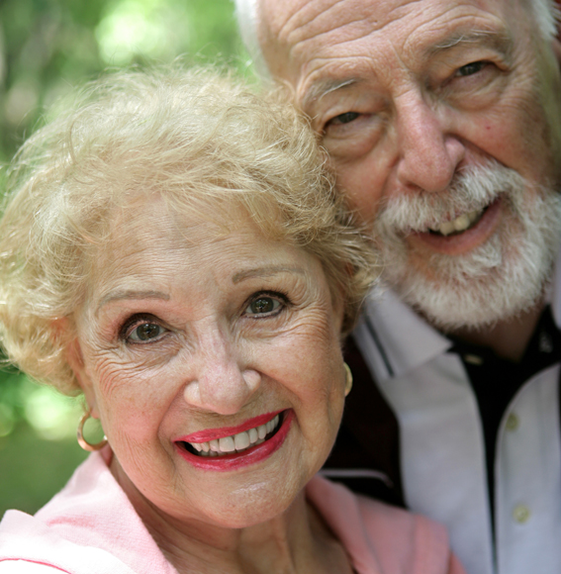
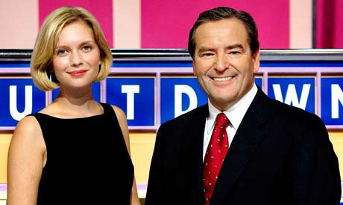
Television Advertising
Viewers are divided into categories – a group of consumers or viewers that share certain characteristics, such as age or income.

Slide 8
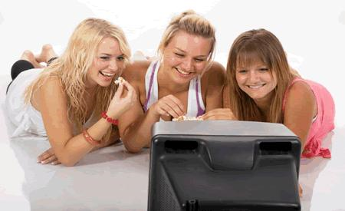
The number of people in a category that could be watching is called a universe.

Slide 9
For example…
Children can be targeted by using advertising slots on CITV.
Adults can be targeted by using advertising slots in peak viewing times like when X Factor or Coronation Street are on.

Slide 10
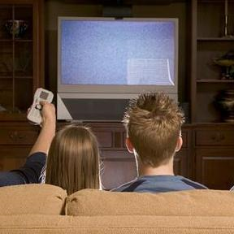
Every time a viewer in a particular category watches a TV program it counts as an impact for that category of viewer.
Advertising often targets more than one category.

Slide 11
Advertisers target people based on stereotyping. They assume that a group of people all behave similarly.
I.E. all 20-30 year old males watch football, drink beer and want to drive fast cars.

Slide 12
ACORN category | ACORN group
A – Thriving 1 2 3 | Wealthy achievers, suburban areas Affluent greys, rural communities Prosperous pensioners, retirement areas
B – Expanding 4 5 | Affluent executives, family areas Well-off workers, family areas
C- Rising 6 7 8 | Affluent urbanites, town and city areas Prosperous professionals, metropolitan areas Better-off executives, inner-city areas
D – Settling 9 10 | Comfortable, middle-agers, mature home owning areas Skilled workers, home owning areas
E – Aspiring 11 12 | New homeowners, mature communities White-collar workers, better-off multiethnic areas
F – Striving 13 14 15 16 17 | Older people, less prosperous areas Council estate residents, better-off homes Council estate residents, high unemployment Council estate residents, greatest hardship People in multiethnic, low income areas

Slide 13
Task
Watch the following adverts, considering who you think is being targeted, using the ACORN chart.
L’OREAL advert
Windows 7 phone advert
Corsa advert

Slide 14
Television Ratings
Ratings – the number of people who watch the program, calculated by the BARB (Broadcasters Audience Research Board)
Important in helping advertisers know who is watching and when.
Measured in TVRs: 1 TVR is 1% of the potential audience.

Slide 15
Panels of television are monitored, representing the viewing behaviour of over 24 million households in the UK.
Done electronically.
Data are available for any channel at any minute of the day.

Slide 16
Advertisers will not spend a fortune promoting their product during a show that has poor ratings.
The higher the rating, the more the slot costs.

Slide 17
Analysing television adverts
When analysing television adverts, you should consider the following:
Mise-en-scene – the setting, costumes, body language, etc. used within the advert to convey a message to the audience.

Slide 18
Representation – how are people or places presented in the media text?
Stereotypes – how are certain groups of people represented within the text?

Slide 19
Maslow’s Needs Analysis
Need to survive – food
Need to feel safe – insurance, loans
Need for friendship – help us be popular
Need to nurture – cute and cuddly
Need to achieve – help us succeed
Need for attention – help us get noticed
Need for prominence – show off our social status
Need to dominate – to gain control
Need to find meaning in life – fulfil our dreams

Slide 20
Industry
Makers of TV ads are very creative in trying to sell their product, but they do have to uphold certain standards.
The Independent Television Commission (ITC) monitors all television adverts to ensure they:
Do not use bad language
Are suitable for children to view (prior to 9pm)
Do not represent women in a sexist way
Do not use violent of sexually explicit material
Do not give false facts about their own or rival products

Slide 21
For example….
Guidelines exists for alcohol ads in which drinking cannot be represented as daring or clever, or as bringing success in relationships or other parts of life.
It must also be obvious that the people appearing in the advert are old enough to legally drink.

Slide 22
Things to consider….
While watching TV adverts, take note of:
Use of slogans
Use and placement of text
Font type, size and colour
Where the product is placed
The image(s) that accompany product
Use of sound/dialogue
Where the advert appeared (magazine, channel, time)

Slide 23
Plenary/Homework
While watching television tonight, take note of the adverts that are on during one program you watch between 6-10:30pm.
We will share and discuss these at the start of tomorrow’s lesson.
TIME: PROGRAM: ADVERTS:

