Slide 1
Advertising Across Platforms
Lesson 8

Slide 2
Lesson Objective
At the end of this lesson we will have started work on our practical assessment.

Slide 3
As part of your coursework, you need to show understanding of how antiperspirant products are marketed by producing your own mock print and television adverts.

Slide 4
Coursework Task 2
Design one storyboard and one print based advert for a new antiperspirant/deodorant product. You will need to include a written analysis of your adverts, which explains:
Where your adverts would appear and why
Who your target audience is, and how you made this obvious
How you plan to represent your product (what message/benefits do you want associated with your product)
How you used the codes and conventions typically employed in this type of advertising

Slide 5
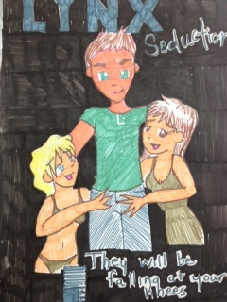
For example
Your handout shows two possible mock print adverts, with written analysis. You either produce a male or female product mock.
You will need to create a television advert that matches your print advert.

Slide 6
Plenary
You will have two lessons to complete each part of the task (four in total).

