Slide 1
Media Unit
Introduction

Slide 2
Lesson Objective
At the end of this lesson we will have discussed how magazines and newspapers attract an audience..

Slide 3
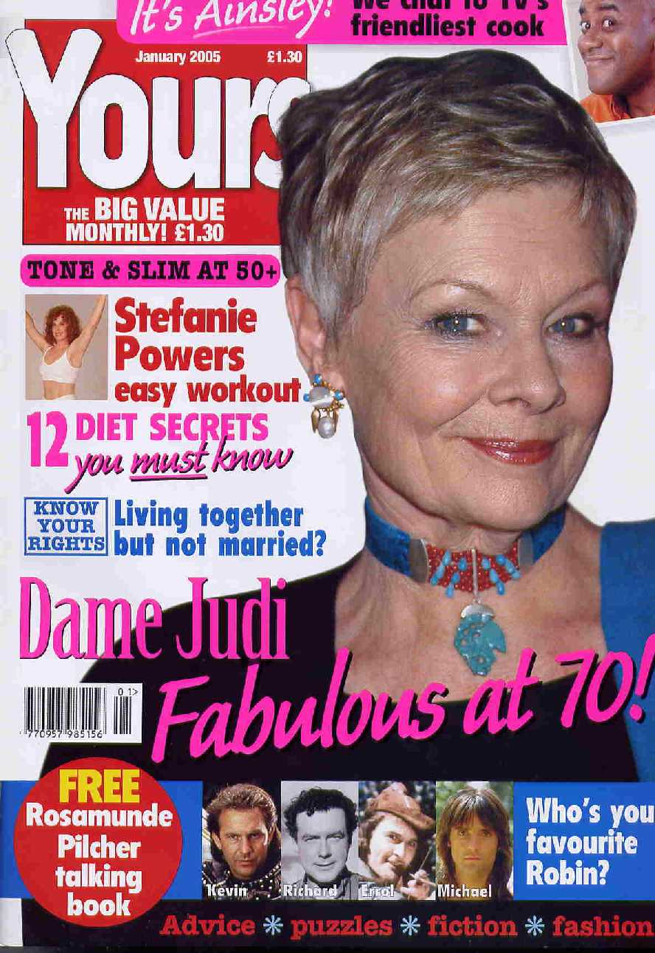
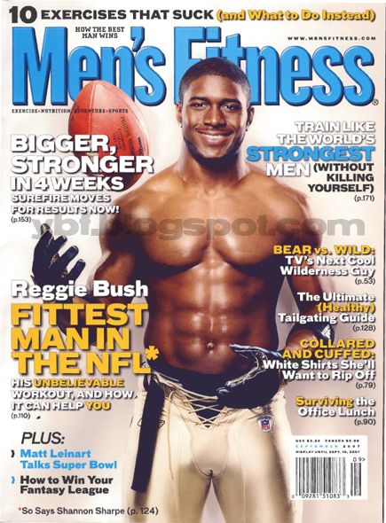
Starter: Magazines
Make a list of magazines that can be found in your house.
Which magazines do you read?
Which magazines do your parents read?
Which magazines do you read? What about your older/younger siblings?

Slide 4
Unit Objectives
Your final task will be to either design a sample for a new celebrity magazine (sets 3,4,5) or an analysis and sample of the Daily Express (sets 1 and 2). Assessment Foci: Writing AFs 2,3,4 and 6

Slide 5
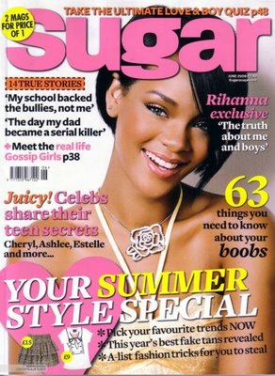
Elements necessary
Front cover – you will need to include an original image on the front cover. Think about this carefully so that it is in fitting with the style and contents of your magazine.

Slide 6
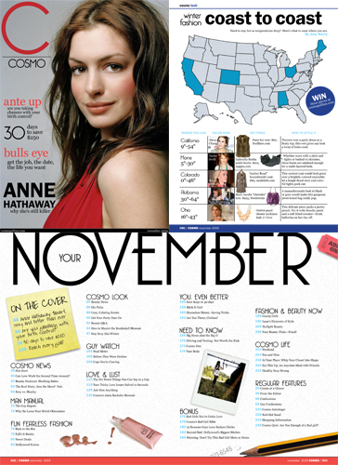
Contents page - Remember that the nature of magazine readers is to ‘flick’ through and stop at interesting features; the contents page should use ‘hooking’ techniques to encourage your audience to turn and read each article. Consider the layout carefully, organising your contents under headings and sub-headings.

Slide 7
An Editorial and Letters to the Editor - include a short editorial, as well as a sample of the types of letters you’d expect to get each month.
Article (Inform/Advise/Review)– write a 500 word article with a clear beginning, middle and end. Think carefully about the perspective your article takes and make sure that this is engaging for your target audience.

Slide 8
Elements necessary
Front page – you will need to include an original image on the front page. Think about this carefully so that it is in fitting with the style and content of your newspaper.

Slide 9
Lead Article – a 500 word article for your newspaper; your article should mimic the visual codes and conventions, as well as the writing style and content, of a newspaper.

Slide 10
What is a magazine?
A magazine can be defined as a collection of articles and stories, published at regular intervals and mainly designed for reading at leisure . Most magazines include photographs.
The word magazine comes from the Arabic word makhazin, which means storehouse; a magazine being a publication that collects together a variety of useful things – a storehouse of information and stories.

Slide 11
How do magazine covers try to entice you to pick up the magazine?

Slide 12
What is a newspaper?
A regularly scheduled publication containing news, information, and advertising, usually printed on relatively inexpensive, low-grade paper such as newsprint.

Slide 13
General-interest newspapers: publish stories on local and national political events and personalities, crime, business, entertainment, society and sports.
Most traditional papers also feature an editorial page containing editorials written by an editor and columns that express the personal opinions of writers.
The newspaper is typically funded by paid subscriptions and advertising.

Slide 14
How do newspapers try to entice you to pick up them up?

Slide 15
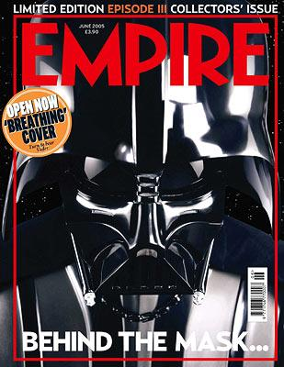
CARP Design Principles
1) Contrast

Slide 16
2) Alignment

Slide 17
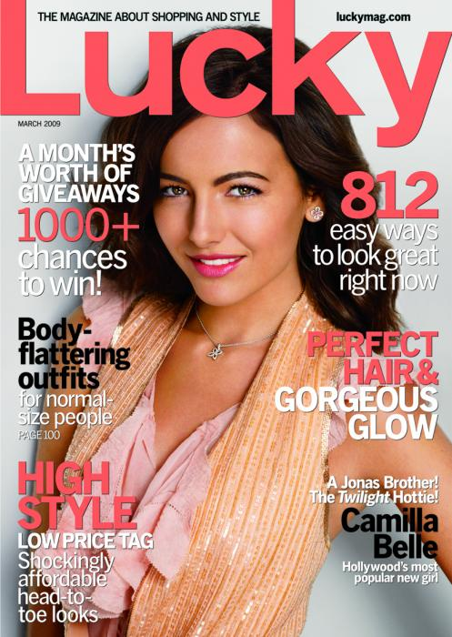
3) Repetition

Slide 18
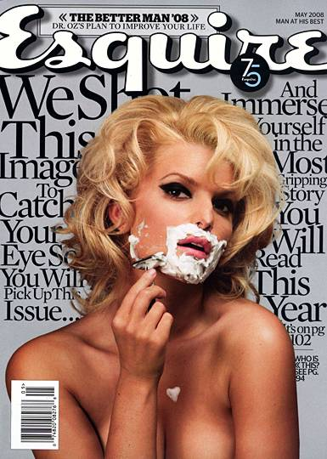
4) Proximity

Slide 19
Activity
Each table group will get one A3 chart (on the next slide).
Each table group will get one magazine cover/front page of a newspaper.
Using the magazine cover/page provided, fill in the chart.
After 5 minutes, switch covers/pagers with another table.
You should work towards filling the chart, using 4 different covers/pages, by swapping three times.

Slide 20
Title of the magazine/Newspaper?
Images and Colours used?
Examples of the stories inside?
Cost/Anything else?
Possible Audience? Why?

Slide 21
Look at the completed table in front of you.
1. List all of the things you would expect to see on the front cover of a magazine/newspaper
Now look at the images that are used on the different types of magazines and the different stories you can read in each.
How do the covers tell us the type of audience for each magazine/newspaper?

Slide 22
Looking at the covers at the front of the class…
When asked, make at least three points to show how the front cover suits its audience

