Slide 1
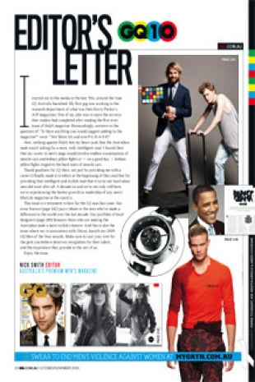
Media Unit
Editorials

Slide 2
Lesson Objective
At the end of this lesson we will have produced an editorial/editor’s letter

Slide 3
Starter
What is the role of an ‘editor’?

Slide 4
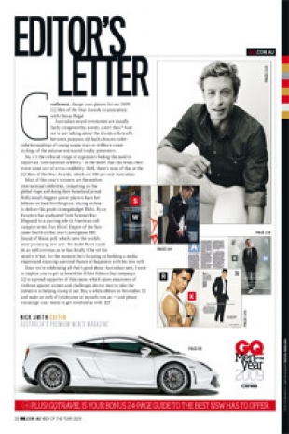
Editorial/
An opinion piece written by the senior editorial staff or publisher of a newspaper or magazine.
Editorials are usually unsigned and may be supposed to reflect the opinion of the medium.
Most print publications feature an editorial, or letter followed by a Letters to the Editor section.

Slide 5

Task
Skim through the editorial given to you.
Write down a list of features used in the editorial.

Slide 6
Features of an editorial
Include information about what is contained in the rest of the magazine/paper.
  Includes page references
States the opinion of the editor. Opinions can be about:
  What is contained in the magazine (content)
  A hot topic at the time of publication
The masthead/staff box (if this isn’t on the contents page)
Images relating to content.
Contents page (optional)

Slide 7
Remember, the editorial may state the opinion of the editor specifically, but it also reflects on the general opinion of the magazine or newspaper.

Slide 8
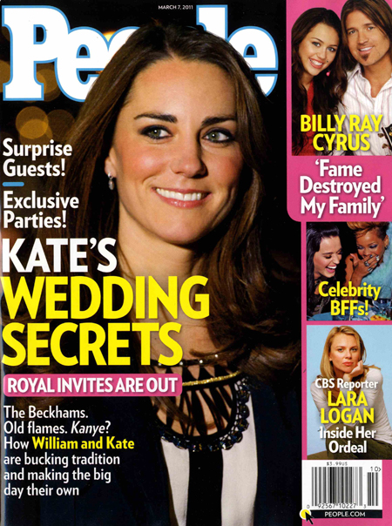
TASK
Imagine you are writing an editorial for the following magazine:

Slide 9
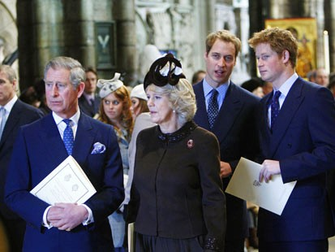
TASK
Imagine you are writing a newspaper editorial on the role of the Royal Family in modern society.

