Slide 1
Media Unit
Analysing Media Texts

Slide 2
Lesson Objective
At the end of this lesson we will have discussed how the British media presented the vuvuzela debate during the 2010 World Cup in South Africa.

Slide 3
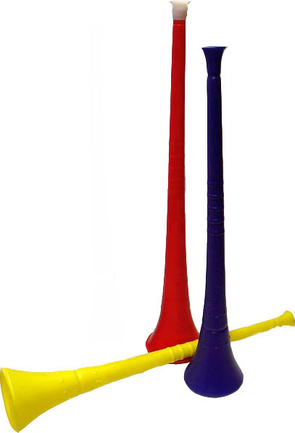
What do you know about the vuvuzela?

Slide 4
In a nutshell…
It is a blowing horn up to approximately 1 m (3 ft) in length. It is commonly blown by fans at association football matches in South Africa.
The instrument is by blowing through compressed lips to create a buzz.

Slide 5
The Controversy…
Associated with permanent noise-induced hearing loss
A possible safety risk when spectators cannot hear evacuation announcements
May spread colds and flu viruses on a greater scale than coughing or shouting.

Slide 6
The Controversy…
Blamed for drowning the sound and atmosphere of football games.
Commentators have described the sound as "annoying”.
The sound level of the instrument has been measured at 127 decibels contributing to football matches with dangerously high sound pressure levels for unprotected ears.

Slide 7
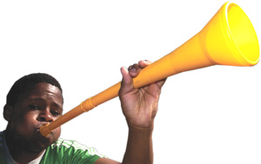
What does this have to do with media?
Well, the media affects us all on a daily basis, whether you know it or not. Consider the vuvuzela debate….

Slide 8
Analyzing article content
Look at the tone of the article.
How does the author speak to the reader? What reading level are the articles written in? For example, most commercial magazines are written in a casual tone directly to the reader (using "you" and "your").

Slide 9
Look at the use of headings and subheadings.
What do the headings/subheadings say? Are they meant to grab the readers attention? Why do they do this? How do they do this?

Slide 10
Look for quotes.
What is being said, and by whom? Are the people quoted trustworthy sources, or are they merely meant to appear important, to engage the reader?

Slide 11
Examine key words and phrases. What sort of language is used, and how does that contribute to your sense of audience?

Slide 12
What category does the article fit into? What is the purpose of the article?

Slide 13
Is the article effective? Does it appeal to you? Why or why not? Would the article appeal to the target audience of the magazine? Why or why not?

Slide 14
Task
Read through both of the articles provided to you, and answer the questions in your workbooks. Please write in full sentences!

Slide 15
Extending the task
Paragraph one: Discuss how the vuvuzela is represented in one of the articles.
Once you’ve completed the questions, move on to answering the question at the bottom of the handout. Please write in paragraphs.
Paragraph two: Discuss how the vuvuzela is represented in the second article.
Paragraph three: Discuss any similarities and differences between the two articles.
Paragraph four: State your personal opinion on the matter; which argument do you support?

Slide 16
Plenary
How has the media shaped your understanding of the vuvuzela issue at the 2010 World Cup?

