Slide 1
Creative Media
Unit 1 lesson 13

Slide 2
Lesson Objective
At the end of this lesson we will have analysed representations in film and television.

Slide 3
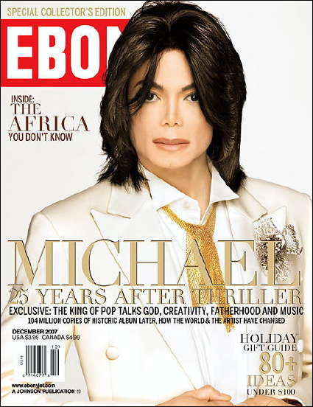
Starter
In pairs, consider how Jackson is being represented here.

Slide 4
Print vs film
Moving media, such as film and television, construct representations of people in the same way that print media do.
Consider the video for ‘Smooth Criminal’

Slide 5
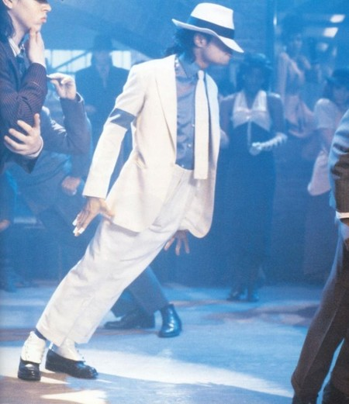
Smooth Criminal
How does Jackson choose to represent himself in the video?

Slide 6
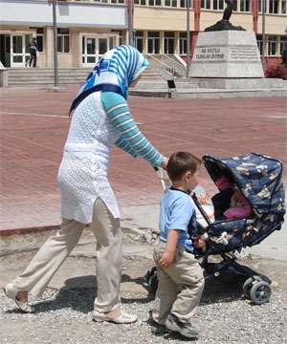
Representation
Some representations can affect how we see whole groups of society.
In today’s lesson we shall analyse media representations in film and television.

Slide 7
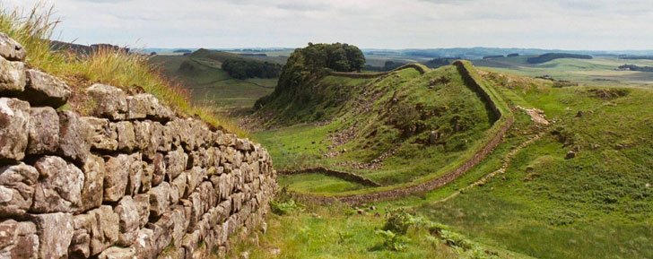
Representation
How are people from Northern England represented in film and television?

Slide 8
Representation
How may these impressions affect the way we see people from the North in real life?

Slide 9
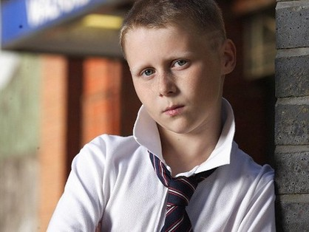
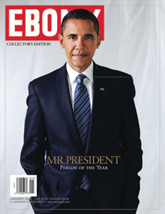
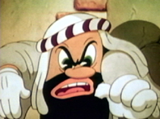
Representation

Slide 10
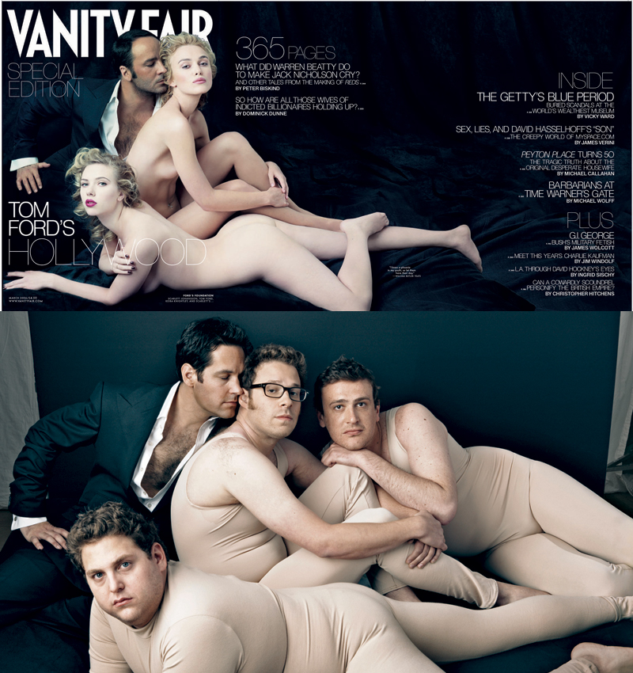
What does this Vanity Fair cover (top) and spoof by Hollywood comic actors (bottom) tell us about media representations?

Slide 11
Media representations
Watch the following clips, commenting on how various people are represented.
Mean Girls
Masculinity in Disney Films
Gender in Advertising

Slide 12
Plenary
Write a brief paragraph explaining how gender is represented in the media, based on the clips we’ve watched today.

