Slide 1
Creative Media
Unit 1 Lesson 3

Slide 2
Lesson Objective
At the end of this lesson we will have studied codes and conventions used in printed media texts.

Slide 3
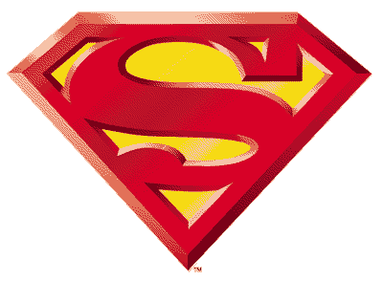
Can you name: i) the signifiers ii) what they signify (at least 5 meanings/associations)
B
C
A
D
E

Slide 4
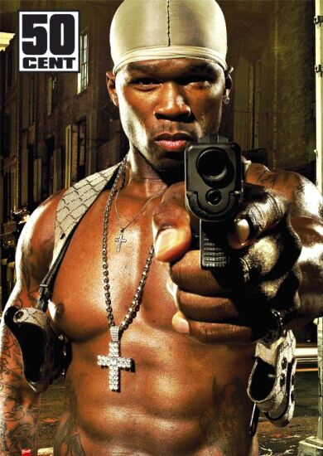
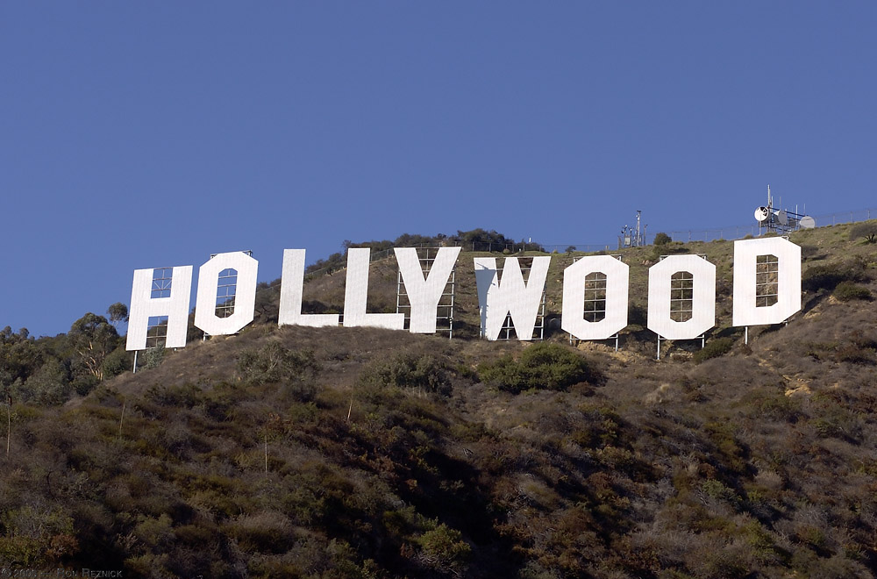
What do the following images: i) denote ii) connote
A
B

Slide 5
Comparing Imagery
In pairs, discuss and make notes on the following:
What is the denotative level of meaning in each image? What does each image denote?
What is the connotative level of meaning in each image? What does each image connote?
Why do you think different images have been chosen?
What meanings do the images convey to audiences?

Slide 6
Introduction to Semiotics: Written Codes
The study of written codes includes:
Slogans
Typeface/Font
Headlines
Captions
Style
Choice of words
Emphasis of words

Slide 7
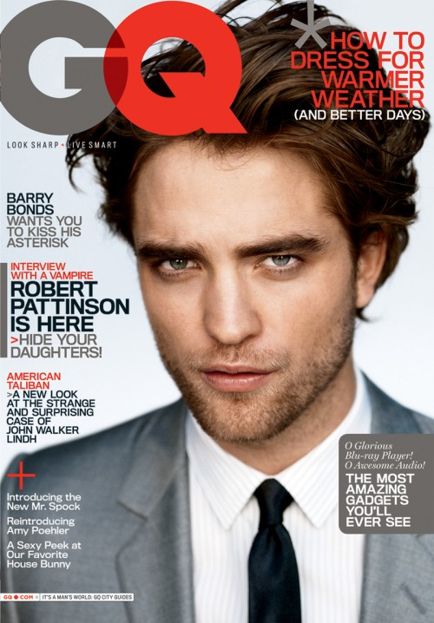
Analysing Written Codes
What is the title of the magazine and what does this connote?
What slogans/captions have been used?
What colours are used and what do they connote?
What font has been used and what does this connote?
What words have been chosen? Why do you think they have been chosen?
What words are emphasised and why do you think they have been emphasised?

Slide 8
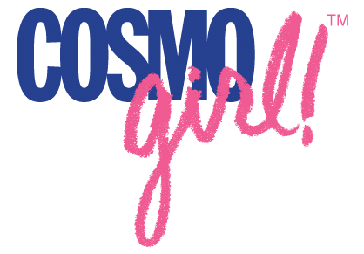
Fonts: What do the following fonts connote/signify?

Slide 9
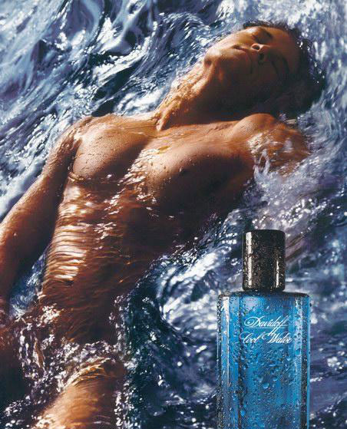
SIGNIFIER: Water/Ocean Wave
SIGNIFIES:
Wild, Stormy, Natural, Earthly
SIGNIFIER:
Facial Expression/Body Language
SIGNIFIES:
Ecstatic, pleasure lost in ecstacy, laid back, inviting
SIGNIFIER:
Mans Naked Torso
SIGNIFIES:
Natural, angelic, pure, toned, ideal, masculine, adonis
SIGNIFIER: Words ‘Cool Water’
SIGNIFIES:
Refreshing, different,
SIGNIFIER: Droplets on Bottle
SIGNIFIES:
Cool, chilled appearance, almost drinkable
SIGNIFIER: Calligraphy Style Font
SIGNIFIES:
Classic, timeless, expensive tastes

Slide 10
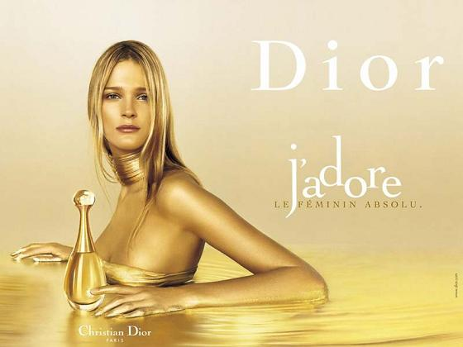
SIGNS: Blonde Hair
Signifies:
Ideal Woman, Innocence, Looks ‘gold’
SIGNS: Jewellery
Signifies:
Extravagance, Excess, Glamour, Decedance
SIGNS: Font
Signifies:
Dior Logo, Brand Name, Designer
SIGNS: Word ‘Love’
Signifies:
Passion, Excitement, Lust
SIGNS: Colour Gold
Signifies:
Luxury, Riches, Expense, Success, Shimmering
SIGN: Perfume Bottle
Signifies: Looks Jewel-like, Buried Treasure

Slide 11
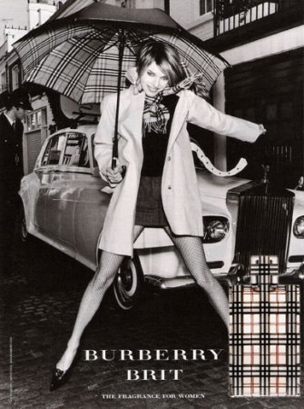
TASK
Use arrows to highlight:
A) The key signifiers
B) Their connotative meaning

Slide 12
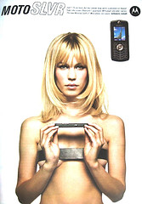
Slide Show
Gender Representations in Advertising
Goffmans Theory (1972)
In the portrayal of men and women, advertising often uses the following codes and conventions:
Superiority, Domination & Body Language: Men are shown in dominant positions; appear to be reflective of thought and intelligence. Women are physically portrayed in sexual or reclining poses with blank or inviting expressions.

Slide 13
Slide Show
Gender Representations in Advertising
Goffmans Theory (1972)
In the portrayal of men and women, advertising often uses the following codes and conventions: Dismemberment: On females, parts of the body such as legs, chest, etc., are used, rather than the full body. This is often applied to sell products which are not related to the body, such as mobile phones (right)

Slide 14
Slide Show
Gender Representations in Advertising
Goffmans Theory (1972)
In the portrayal of men and women, advertising often uses the following codes and conventions: The Voice-Over Authority: In moving image advertisements, male voices are used as voice-over's in commercials rather than females.

Slide 15
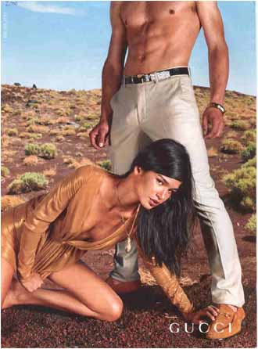
A
B

Slide 16
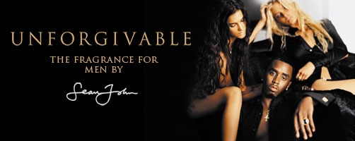

Slide 18
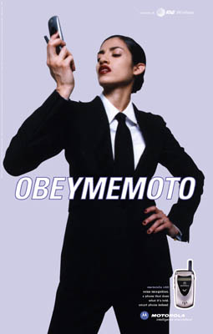

Slide 19
Your task: Carry out a Semiotic Analysis of an advertisement commenting on the relevant headings listed below:
1. SYMBOLIC & WRITTEN SIGNIFIERS
Lighting & Colours
Positioning of Words & Images
Setting & Locations
Facial Expressions & Body Language (of people)
Typeface/Font Style
Key (Main) Images/Signifiers
Clothing, Hair & Make Up
2. Goffman’s Theory
Does the advert adhere to Goffmans gender theory? Comment on the representation of men/women featured within the advert?
Minimum of 500 words please.
Due….

