Slide 1
Creative Media
Unit 1 Lesson 7

Slide 2
Lesson Objective
At the end of this lesson we will have studied sound and music in media, and the effect they have on the audience.

Slide 3
Mise-en-scene
In the same what the camera angles and audience positioning are used for a particular effect, so too is sound.

Slide 4
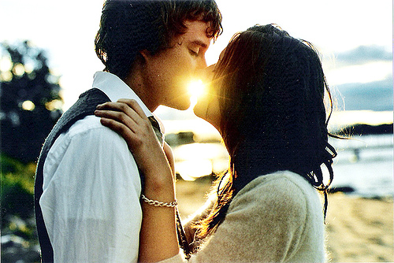
Consider the following…
What types of music would you expect to be used for the following types of scenes:

Slide 5
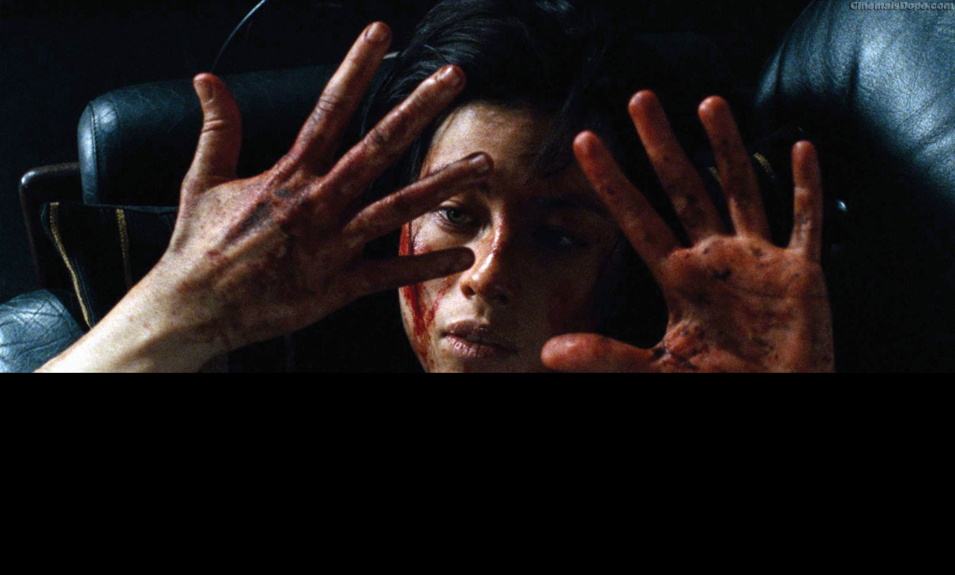

Slide 6
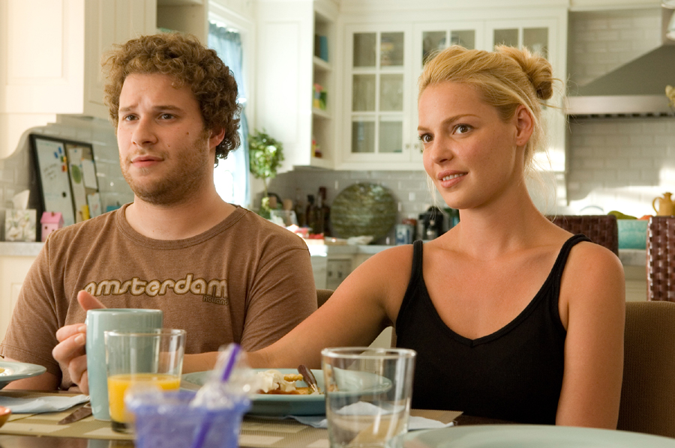

Slide 7
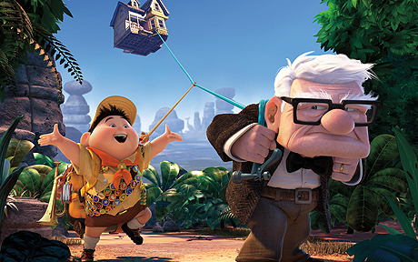

Slide 8
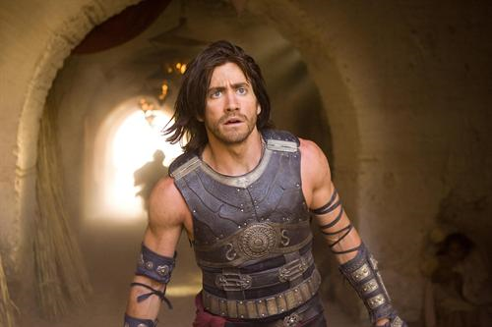

Slide 9
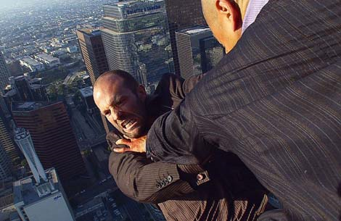

Slide 10
Mise-en-scene
Remember that in media texts, sound is just as important as any other element.
Each thing that you hear has been carefully selected and chosen for a reason – to elict a certain response from the audience.
Your job now is to determine what that effect is, and whether or not it had the desired effect.

Slide 11
Ambient Sound
The sounds of everything going on around the person who is speaking.
For example, the sound of waves and wind on a beach scene.

Slide 12
Synchronised Sound
The words are spoken to match the lip movements of the speaker
Often used in music videos or musical programs.

Slide 13
Voice-over Sound
Sound that is dubbed onto any picture sequences.
Documentaries and advertisements often use a lot of voice-over.

Slide 14
Sound Effects
Usually added to the soundtrack at the dubbing stage. Sound effects can be sub-divided into two types:
Sounds to match actions of events on the screen (for example a door slamming, or glass breaking)
Sounds that are about a scene but do not match anything actually shown (for example the sound of birds singing might accompany a scene in the countryside)

Slide 15
Music
Music is the final sound added to film/television shows in post-production.
Music is used to make the audience feel certain emotions as they watch the action on screen.
In high-budget film or television productions, specially composed music will be commissioned for the soundtrack.

Slide 16
Task
Consider the following clips. For each one, record how sound and music was used for effect. For example: The scene starts off with a nostalgic, historical sounding song with lyrics stating ‘we’ll meet again’. This works to establish that the woman in the scene is quite old, and that she has been separated from her husband through death. It implies that they will meet again in Heaven.

Slide 17
Use the following clip to write a detailed review of the scene. Be sure to write in paragraph form, and make reference to shot types, audience positioning and sound effects.
Final clip for analysis
Clip 1
Clip 2
Clip 3
Clip 4
Clip 5

Slide 18
Plenary
How do sound effects and music work to enhance scenes within a film?
Can specific genres be said to have conventional sound effects/music?

