Slide 1
Creative Media
Unit 1 Lesson 8

Slide 2
Lesson Objective
At the end of this lesson we will have studied how lighting is used in the media, and the effect it has on the audience.

Slide 3
Starter
Consider the following film posters. How well do they communicate the genre, characters and events of the film being advertised?

Slide 4
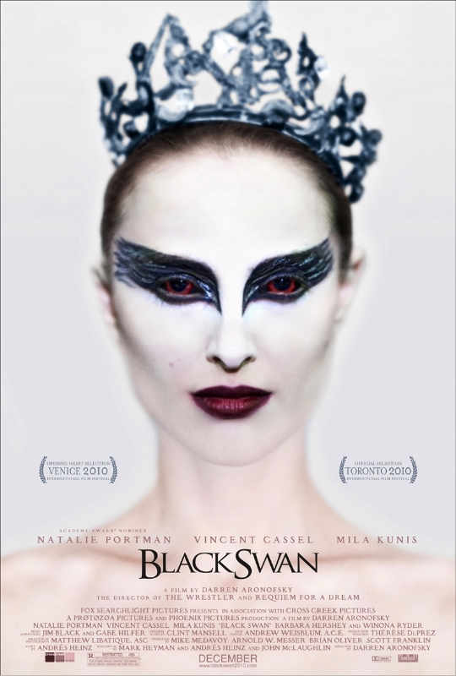

Slide 5
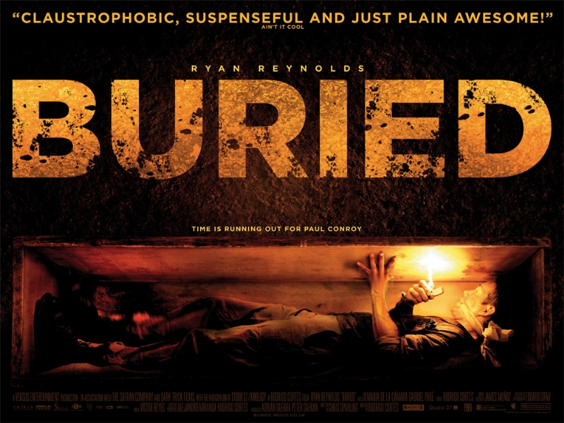

Slide 7
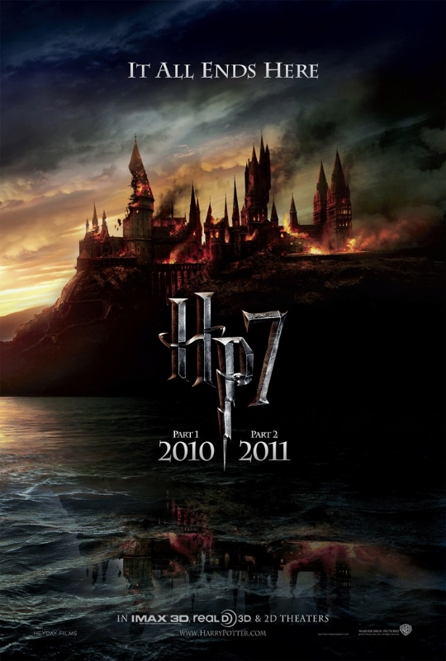

Slide 8
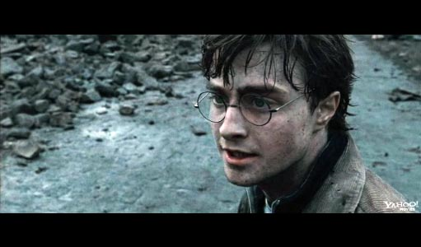
Mise-en-scene
In the same way that camera angles, audience positioning and sound/music are used for a particular effect, so too is lighting.

Slide 9
Mise-en-scene and lighting
Remember that in media texts, lighting is just as important as any other element.
Everything that you see has been carefully selected and chosen for a reason – to elict a certain response from the audience.
Your job now is to determine what that effect is, and whether or not it had the desired effect.

Slide 10
If the lighting for a shot is wrong, the shot will look dead, people can look washed out, and things become less clear.
Consider the following types of lighting:

Slide 11
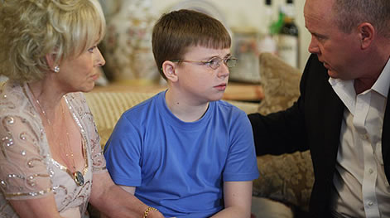
Realistic Lighting
used so that actors and sets are lit so naturally that the audience do not notice the technology that has been used to simulate reality.
Often used in romantic comedies and soap operas.

Slide 12
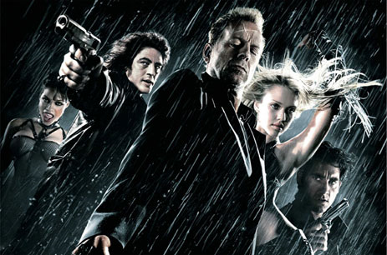
Expressive lighting
When the director uses light to set a mood or tone for a scene – or even a ‘look’ to a whole film.
Films like Sin City and The Dark Knight have expressive lighting designs.

Slide 13
High-Key picture
Makes the shot look very bright overal with small areas of shadow.
A bright, sunlit outdoor scene is high key.

Slide 14
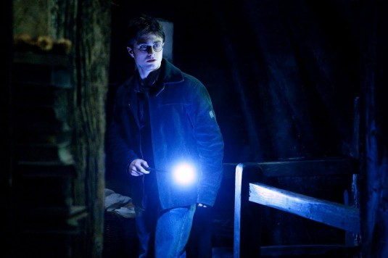
Low-key picture
Makes the shot look dark overall with few areas of highlight.
There may be one section of the shot which is brightly lit while the rest is in deep shadow.
Night shots or interiors are often low-key.

Slide 15
Task
Clip 1
Clip 2
Clip 3
Consider the following clips. For each one, record how lighting was used for effect.

Slide 16
Final Task
Use the following clip to write a detailed review of the scene. Be sure to write in paragraph form, and make particular reference to how lighting is used for effect.
Final clip for analysis
High –key picture
Low-key picture
Expressive lighting
Realistic lighting

Slide 17
Plenary
How does lighting work to enhance scenes within a film?
Can specific genres be said to have conventional lighting effects?

