Slide 1
Television
Lesson 2

Slide 2
Lesson Objective
At the end of this lesson we will have looked at the title sequences of various soap operas.

Slide 3
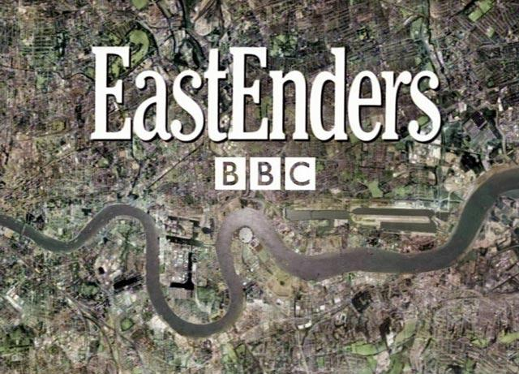
Starter
What can you see in these images? What does this tell us about the program?

Slide 4
Title Sequences
A title sequence is a series of shots and music or graphics that appear at the start of a program.
Examining title sequences can tell us a lot about the codes, conventions and messages employed at the start of television media texts.

Slide 5
Comparison
Compare the title sequences for Eastenders, Coronation Street, Emmerdale and Hollyoaks. While watching, pick out features that give you clues about the program (what is it about, where does it take place, who is in it, etc).

Slide 6
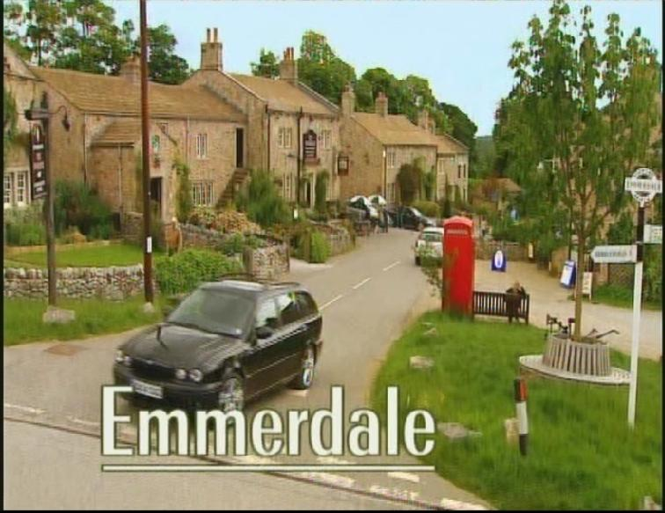
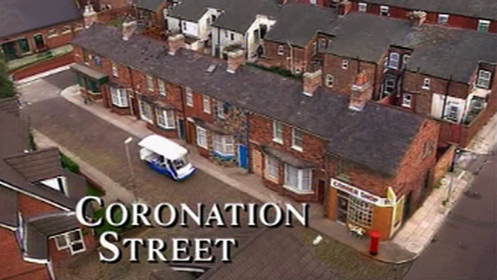
Title Sequences
What is the main difference between the title sequences for Eastenders, Coronation Street and Emmerdale versus that of Hollyoaks?

Slide 7
Why would Eastenders, Coronation Street and Emmerdale choose not to include characters in their title sequence?
Due to the various cast changes on soap operas, they often do not include characters; it would be too costly to change the title sequence regularly.

Slide 8
Analysing media texts
There are three distinct areas to consider:
Technical Codes: How the sequences are filmed.
CODES
Symbolic Codes:
How cultural symbols inform the audience about the text.
Written Codes: How text on the screen conveys meaning

Slide 9
Technical Codes
Any technical process used to create the text. These include:
Shot types – establishing shots, long shots, etc.
Transitions – fades, wipes, dissolves, etc.
Angles – low, high, canted, etc.
Camera movements – zooming, panning, tracking, etc.

Slide 10
Technical Codes
Consider the technical codes used by Eastenders
Shot types –
Transitions –
Angles –
Camera movements –

Slide 11
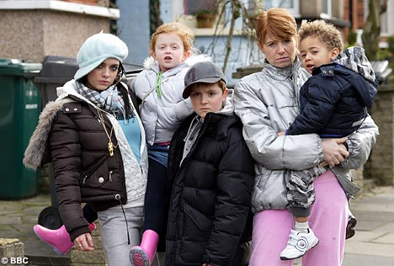
Symbolic Codes: Meaning in what you see
Situated culture: the everyday surroundings and modes of behaviour shared with others from a similar cultural background.
Can include the use of:
Objects
Setting
Body language
Clothing
Colour
Soundtrack

Slide 12
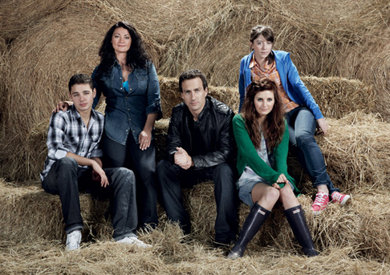
Task
What can you tell about the characters in each of the following programs, based on looking at symbolic codes?

Slide 13
Task
What can you tell about the characters in each of the following programs, based on looking at symbolic codes?

Slide 14
Task
What can you tell about the characters in each of the following programs, based on looking at symbolic codes?

Slide 15
Task
Using the ITV Player, watch the opening two minutes of either Coronation Street or Emmerdale, including the title sequence.
Answer the following questions, using what you observe:
Where do the characters live?
What do each of the characters tell us from their expressions and gestures?

Slide 16
Signature Tune
The signature tune is the soundtrack played over the images in the title sequence. For example ‘the duff duffs’.
This soon becomes recognizable to the audience and is seen to ‘belong’ to the program, like a signature.

Slide 17
Task
Consider the signature tune for Neighbours.
What do the lyrics tell us about the story?
What other signature tunes can you think of that signal the theme of a program?

Slide 18
Written Codes
Includes looking at:
Font style and size
Position and movement of the text
How does the text signal the genre of the program? Why has it been chosen?

Slide 19
Written Codes
What does the font below tell us about genre?
Lucida Handwriting
Chiller
Kristen
Jokerman
Matura
Playbill

Slide 20
Task
Compare the written codes used in each of these soap operas. Write a paragraph-style analysis.

Slide 21
Plenary
Of the four opening sequences we looked at today, which do you feel most effectively portrays the message/genre of the program, and why?

