Slide 1
Television
Lesson 3

Slide 2
Lesson Objective
At the end of this lesson we will have considered how the study of semiotics helps to analyse meaning.

Slide 3
RANDOM FACT!
Did you know that in 2008 the three main US television networks produced 1.5 million hours of television. However, YouTube produced the same amount in six months time… What does that say about the future of television?

Slide 4
Recap!
Who can explain denotation?
Who can explain connotation?
RED

Slide 5
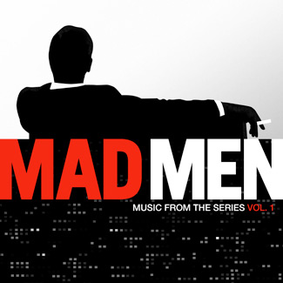
Consider the following title sequence for ‘Mad Men’, focusing on the use of the colour red.

Slide 6
What sort of assumptions can we make about the show ‘Mad Men’ based on the title sequence?

Slide 7
Definition - Semiotics
Semiotics: the study of how meanings, images etc. are constructed. Semiotics assume that media are structured to influence the very reality that they are meant to ‘describe’ or ‘stand for’.

Slide 8
Semiotics involves the study of signs.
Saussure’s two signifiers:
Physical signifier – a gesture, words on a page, music
Immaterial signified – an idea associated with the gesture, word, music etc.

Slide 9
For example
Sign R – O – S – E ‘Rose’
Signifier
The words on the page R-O-S-E are commonly known to refer to a rose. Semiotics state that there is a difference between the sound of the word ‘rose’ and our concept of what a rose is.

Slide 10
Our perception of reality is constructed and shaped by the words and signs we use.
The language we use determines our sense of things, rather than our sense of things being determined by our language.

Slide 11
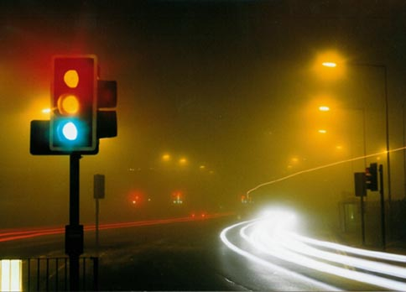
Pierce’s three signs
Symbol: The relation between the sign and what it stands for is arbitrary (we can’t pin-point a meaning. For example, traffic lights).

Slide 12
Pierce’s three signs
Icon: Signs that resemble what they stand for (a drawing, photo or film of something).

Slide 13
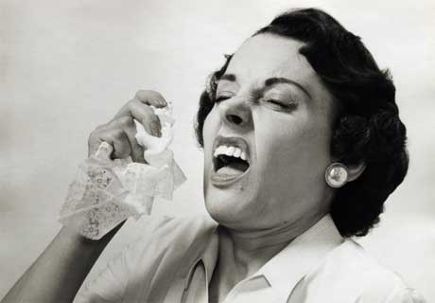
Pierce’s three signs
Index: There is a causal link between the sign and what it stands for (for example, a runny nose is a sign of a cold, smoke is a sign of fire).

Slide 14
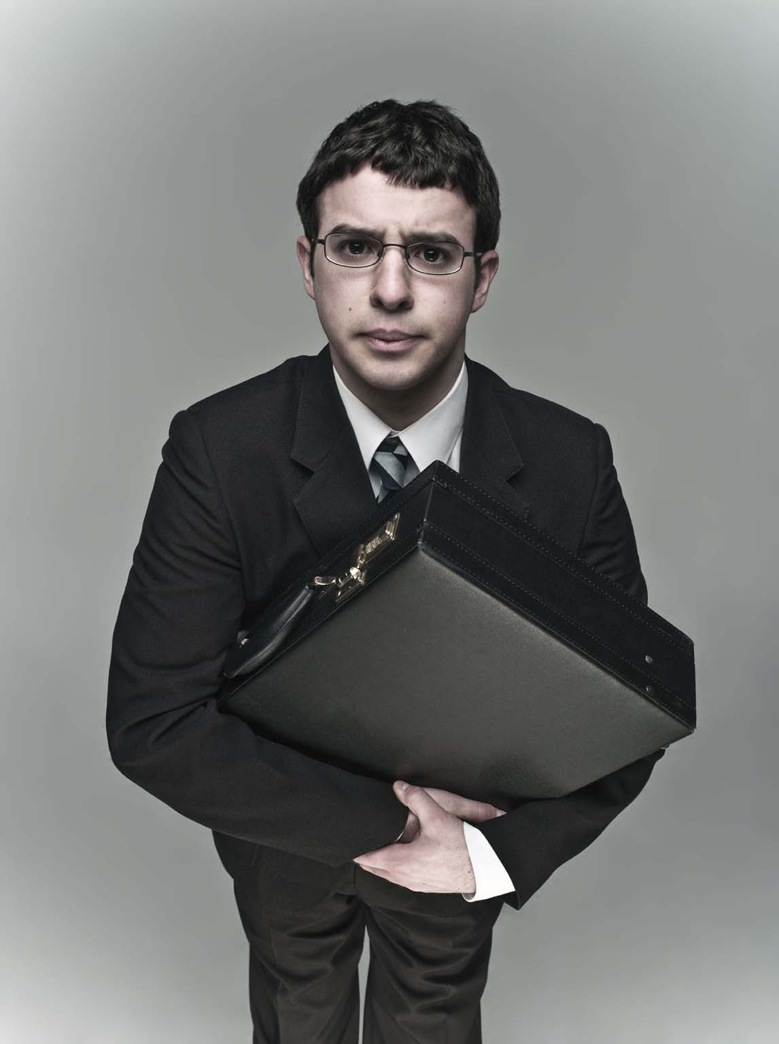
Using Semiotics
Watch the following title sequence for ‘The Inbetweeners’ commenting on the signs and signifiers used.

Slide 15
Using Semiotics
Signs/Signals – gestures, movement, music and meaning associated with them.
Symbols – arbitrary, assumed images/meaning
Iconics – representations of images for a specific meaning
Indexes – causal links between images and meaning.

Slide 16
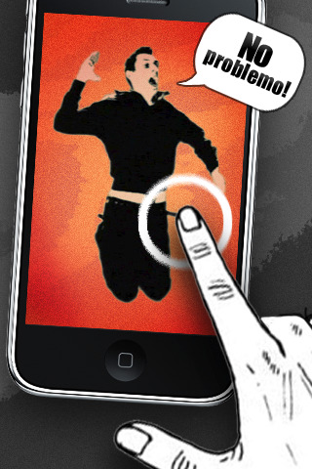
Using Semiotics
Signs/Signals – images are used to represent main characters. Still frames that move – like stop-go animation. Boys are shown standing, sitting, mid-jump, which suggests lighthearted, comical characters. Music is fun, up-beat.

Slide 17
Using Semiotics
Symbols – jumping, sunglasses = laid back, fun, goofy. Trainers and denim = relaxed and youthful. Boys = lads. Standing together = friends.

Slide 18
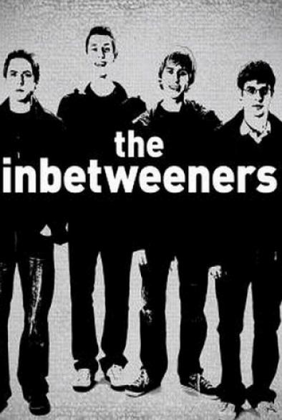
Using Semiotics
Iconics – goofy, relaxed pictures of boys as young, carefree lads. The show is about these boys.

Slide 19
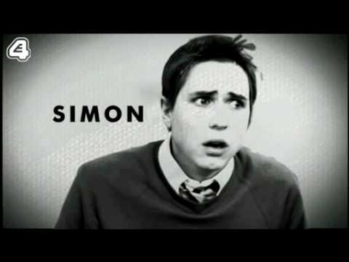
Using Semiotics
Indexes – One character has glasses – the uptight nerd; one character wears shades – the cocky one; one character always looking in distance – the dreamer; one character active – the stupid jock.

Slide 20
Using Semiotics
What reality does ‘The Inbetweeners’ try to describe?

Slide 21
Plenary
Watch the following title sequence for ‘The IT Crowd’.
Write a paragraph-style response that analyses the title sequence. You should comment on:
Technical codes (camera angles, music, etc)
Written codes (font type/size, position)
Symbolic codes (signs, symbols, what you see vs what it tells you, semiotics – what reality is being described, and how?).

