Slide 1
Television
Lesson 4

Slide 2
Lesson Objective
At the end of this lesson we will have practiced analysing a variety of title sequences for meaning, and produced our own storyboard.

Slide 3
Starter
What does the following still image tell us about the program being represented? Be sure to consider the various codes (technical, symbolic and written).

Slide 4
Task
As a class we will watch a series of different title sequences. While watching, take notes about how meaning is conveyed through images and soundtrack. Consider:
How location and time are established
How groups of people are represented, if at all
How the soundtrack gives clues about the content
How any lettering used relates to the rest of the sequence.
How signs and symbols are used to influence meaning.

Slide 5
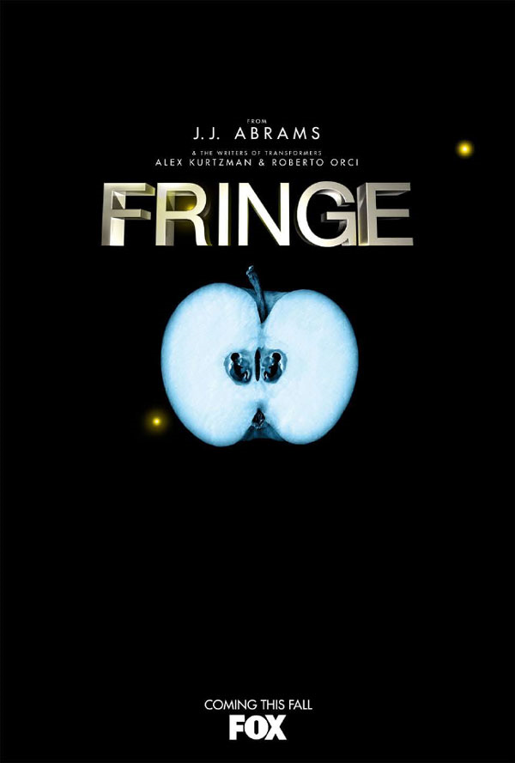
Clip 1: Fringe
location and time
representations
soundtrack
lettering
signs and symbols

Slide 6
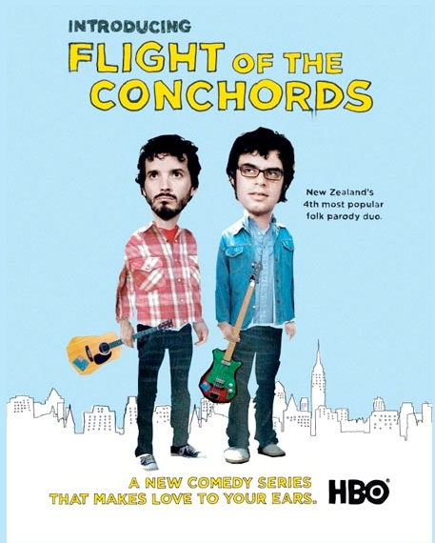
Clip 2: Flight of the Conchords
location and time
representations
soundtrack
lettering
signs and symbols

Slide 7
Clip 3: TOWIE
location and time
representations
soundtrack
lettering
signs and symbols

Slide 8
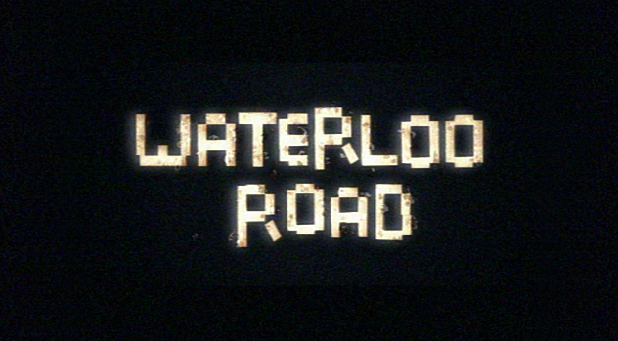
Clip 4: Waterloo Road
location and time
representations
soundtrack
lettering
signs and symbols

Slide 9
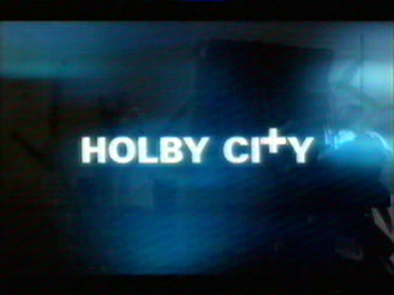
Clip 5: Holby City
location and time
representations
soundtrack
lettering
signs and symbols

Slide 10
Clip 6: Scrubs
location and time
representations
soundtrack
lettering
signs and symbols

Slide 11
Clip 6: Misfits
location and time
representations
soundtrack
lettering
signs and symbols

Slide 12
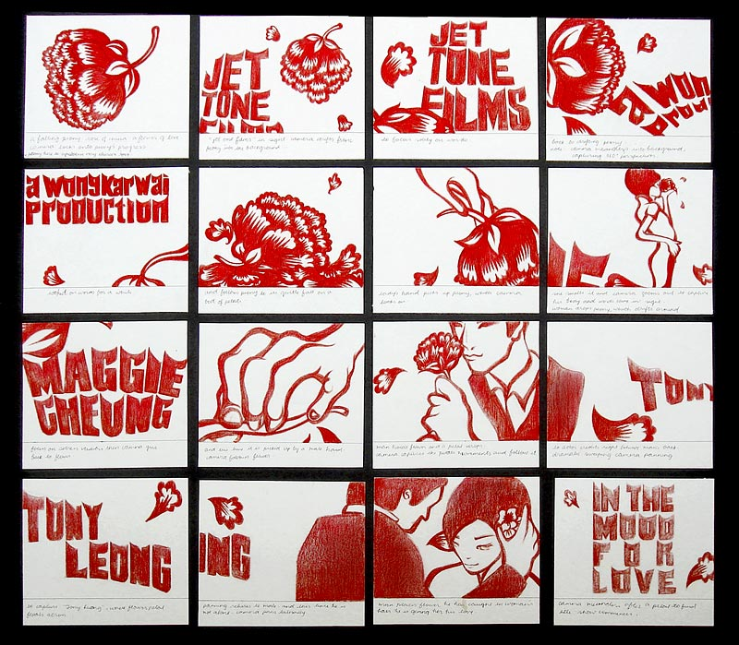
Task
Using what you’ve learnt in past lessons, as well as today, you are to create a short storyboard for the title sequence of your own television program.
Genres to choose from:
Crime drama
Medical drama
Comedy
Soap opera
Sci-fi
Drama (general)

Slide 13
Extended Plenary
Once you’ve completed the story board, write a paragraph style response explaining how your title sequence will effectively show:
The location/time of your program
The characters in your program
What soundtrack will you use, and how will this help signal the genre of your program
Why you’ve chosen a specific font type/size
Any signs and symbols used

