Slide 1
Television L7

Slide 2
Lesson Objective
At the end of this lesson we will have learnt about the various character roles in television.

Slide 3
Starter
Television programs have central characters in order to give audiences someone they can ‘get to know’, which will ensure they return for repeat viewing.
There are various roles characters can play, including
Heroes
Villains
Donors
Dispatchers
Princess/Prize
Think of your favourite television program. Who fills each of these roles in that program?

Slide 4
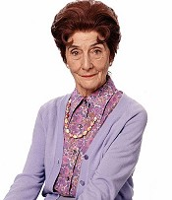
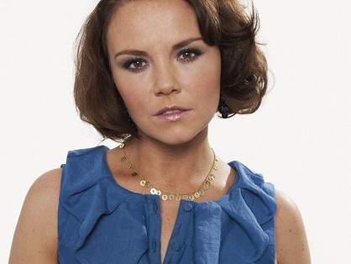
Starter
What sort of facts can we create about each of these characters? What role do they fulfill on EastEnders?

Slide 5
Things to consider when analysing character:
The character’s role in the program
Their relationship with other characters
The ways that the actor brings the character to life:
Use of voice or accent
Movement and gesture
Emotional power to engage the audience.

Slide 6
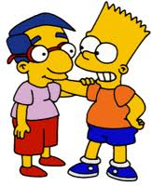
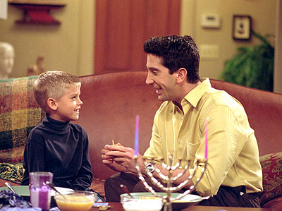
Characters
In drama there are usually two types of characters:
Less important characters who are there for ‘padding’. Often very stereotypical.
Central protagonists, around whom the main narrative(s) centre.

Slide 7
Task
Let’s watch the pilot episode of LOST.
While watching, try to work out who the less important and central protagonist characters are.

Slide 8
Plenary
What information did you use to determine who the important vs less important characters were?

