Slide 1
Film Trailers
Lesson 2: Genre

Slide 2
Lesson Objective
At the end of this lesson we will have created a list of codes and conventions employed in film trailers in certain genres.

Slide 3
Starter
Watch the following clip, commenting on which genre you think the film falls into and why.

Slide 4
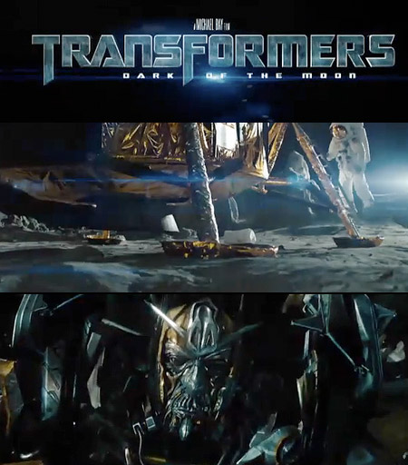
Genre
How can you tell the genre of a film, based on the trailer?

Slide 5
 | Technical Codes (shot types, transitions, camera movement) | Symbolic Codes (images used, representations, music used) | Written Codes (text used, font style used, size, colour
Action Adventure
Comedy
Drama
Documentary

Slide 6
 | Technical Codes (shot types, transitions, camera movement) | Symbolic Codes (images used, representations, music used) | Written Codes (text used, font style used, size, colour
Science Fiction
Horror
Family

Slide 7
Action Adventure
Films where one or more heroes is thrust into a series of challenges that require physical feats, extended fights and frenetic chases.
Story and character development are generally secondary to explosions, fist fights, gunplay and car chases.
Traditionally aimed at male audiences from the early teens to the mid-30s, many action filmmakers have now added female heroines in response to the expanding social conceptions of gender, glorifying the strong female archetype.

Slide 8
Action Adventure Trailers
Watch the following trailers for Action Adventure films. Take notes on how the codes are used, as well as commenting on the following:
How the trailer introduces the story
How the trailer introduce character(s)
How the trailer makes the target audience clear
How the trailer tries to ‘sell’ the film
1
2
3

Slide 9
Codes and Conventions?
What sort of things do the trailers watched seem to have in common?

Slide 10
Comedy Films
the main emphasis is on humour.
traditionally have a happy ending.
puts much more focus on individual stars, with many former stand-up comic transitioning to the film industry due to popularity.

Slide 11
Comedy Trailers
Watch the following trailers for Comedy films. Take notes on how the codes are used, as well as commenting on the following:
How the trailer introduces the story
How the trailer introduce character(s)
How the trailer makes the target audience clear
How the trailer tries to ‘sell’ the film
1
2
3

Slide 12
Codes and Conventions?
What sort of things do the trailers watched seem to have in common?

Slide 13
Dramatic Films
Depend mostly on in-depth development of realistic characters dealing with emotional themes.
Themes include alcoholism, drug addiction, racial prejudice, religious intolerance, poverty, crime and corruption put the characters in conflict with themselves, others, society and even natural phenomena.
Focus mainly on the drama of the main issue.

Slide 14
Drama Trailers
Watch the following trailers for Drama films. Take notes on how the codes are used, as well as commenting on the following:
How the trailer introduces the story
How the trailer introduce character(s)
How the trailer makes the target audience clear
How the trailer tries to ‘sell’ the film
1
2
3

Slide 15
Codes and Conventions?
What sort of things do the trailers watched seem to have in common?

Slide 16
Documentary
A broad category of moving pictures intended to document some aspect of reality.
Described as a "filmmaking practice, a cinematic tradition, and mode of audience reception" that is continually evolving and is without clear boundaries.

Slide 17
Documentary Trailers
Watch the following trailers for Documentary films. Take notes on how the codes are used, as well as commenting on the following:
How the trailer introduces the story
How the trailer introduce character(s)
How the trailer makes the target audience clear
How the trailer tries to ‘sell’ the film
1
2
3

Slide 18
Codes and Conventions?
What sort of things do the trailers watched seem to have in common?

Slide 19
Science Fiction Films
Speculative, science-based depictions of phenomena that are not necessarily accepted by mainstream science.
Includes extraterrestrial life forms, alien worlds, extrasensory perception, and time travel, often along with futuristic elements such as spacecraft, robots, or other technologies.
Often used to focus on political or social issues, and to explore philosophical issues like the human condition.
In many cases, often adapted from novels.

Slide 20
Science Fiction Trailers
Watch the following trailers for Science Fiction films. Take notes on how the codes are used, as well as commenting on the following:
How the trailer introduces the story
How the trailer introduce character(s)
How the trailer makes the target audience clear
How the trailer tries to ‘sell’ the film
1
2
3

Slide 21
Codes and Conventions?
What sort of things do the trailers watched seem to have in common?

Slide 22
Horror Films
Strive to elicit the emotions of fear, disgust and horror from viewers.
Often feature scenes that startle the viewer through the means of macabre and the supernatural, thus frequently overlapping with the fantasy, thriller, and science fiction genres.
Deal with the viewer's nightmares, hidden worst fears, revulsions and terror of the unknown.
Although a good deal of it is about the supernatural, if some films contain a plot about morbidity, serial killers, a disease/virus outbreak and surrealism, they may be termed "horror."

Slide 23
Horror Trailers
Watch the following trailers for Horror films. Take notes on how the codes are used, as well as commenting on the following:
How the trailer introduces the story
How the trailer introduce character(s)
How the trailer makes the target audience clear
How the trailer tries to ‘sell’ the film
1
2
3

Slide 24
Codes and Conventions?
What sort of things do the trailers watched seem to have in common?

Slide 25
Family Films
Designed to appeal to a variety of age groups and, thus, families.
In December 2005, Steven Spielberg's 1982 film E.T. the Extra-Terrestrial came first in a poll of the 100 Greatest Family Films.
The genre today generates billions of dollars per annum.

Slide 26
Family Film Trailers
Watch the following trailers for Family films. Take notes on how the codes are used, as well as commenting on the following:
How the trailer introduces the story
How the trailer introduce character(s)
How the trailer makes the target audience clear
How the trailer tries to ‘sell’ the film
1
2
3

Slide 27
Codes and Conventions?
What sort of things do the trailers watched seem to have in common?

Slide 28
Plenary
Please keep these codes and conventions in mind; when it comes time for you to create your own film trailer, you will be expected to follow the codes and conventions of the genre you choose.

