Slide 1
Lesson Objective
To understand the typical codes and conventions used by the media to portray heroes and villains.

Slide 2
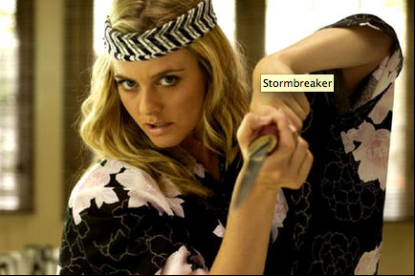
Using the worksheet from last lesson, identify Propp’s character types:
Notes:
Type notes here

Slide 3
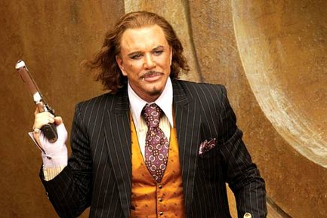
Notes:
Type notes here

Slide 4
Notes:
Type notes here

Slide 5
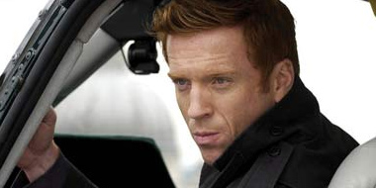

Slide 6
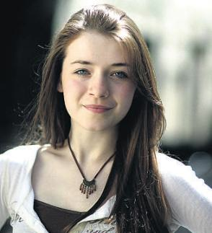

Slide 7
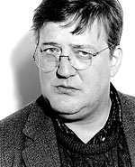

Slide 8
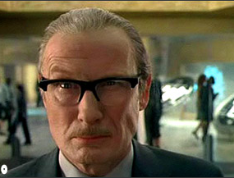
Notes:
Type notes here

Slide 9
Create a list of top ten features (looks, personality, the way they act) a hero should have
Now, create a list of top ten features a villain should have

Slide 10
Heroes and villains in the media
We are going to explore how heroes and villains are portrayed in the media by looking at existing examples. Create the following table:
 | Are they a hero or a villain? | List three reasons why you have come to this decision.
1
2

Slide 11
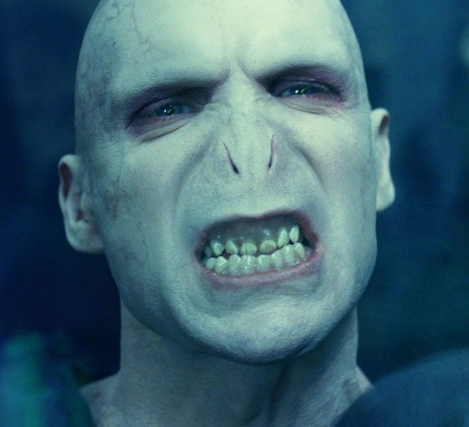

Slide 12
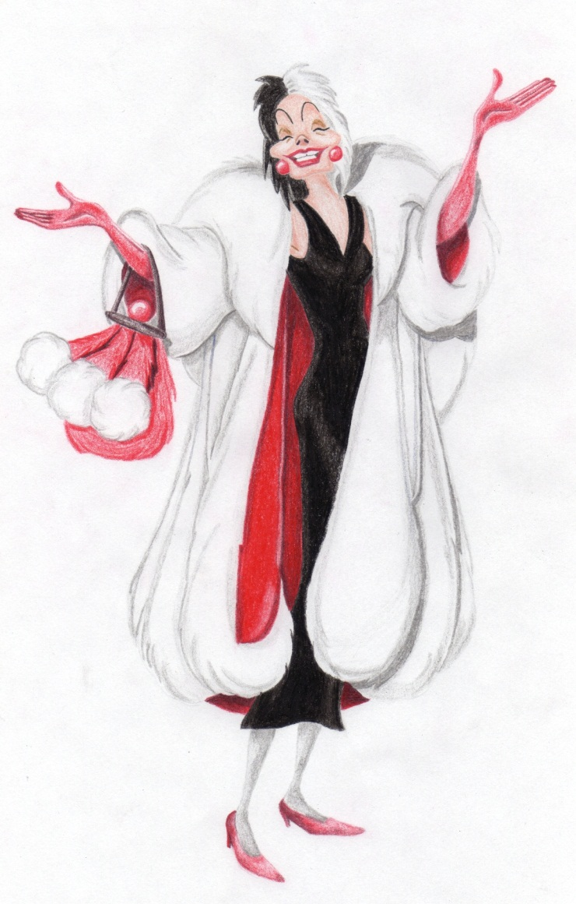

Slide 13
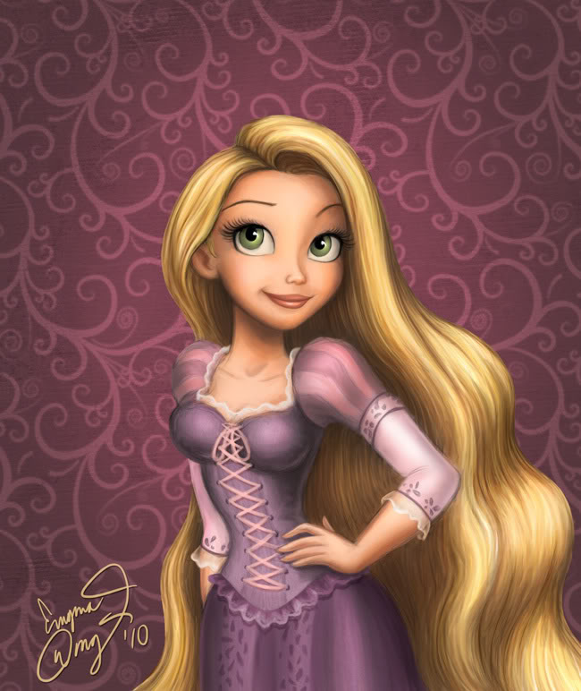

Slide 14
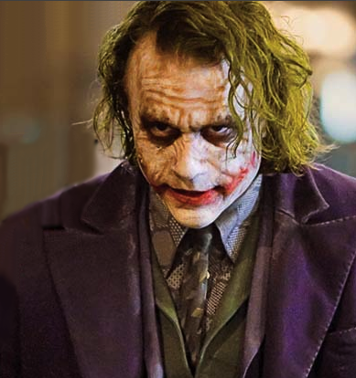

Slide 15
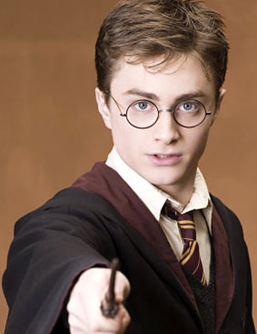

Slide 16
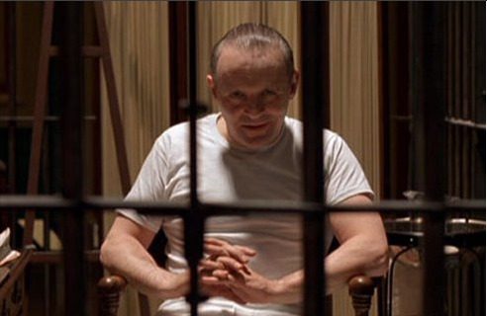

Slide 17
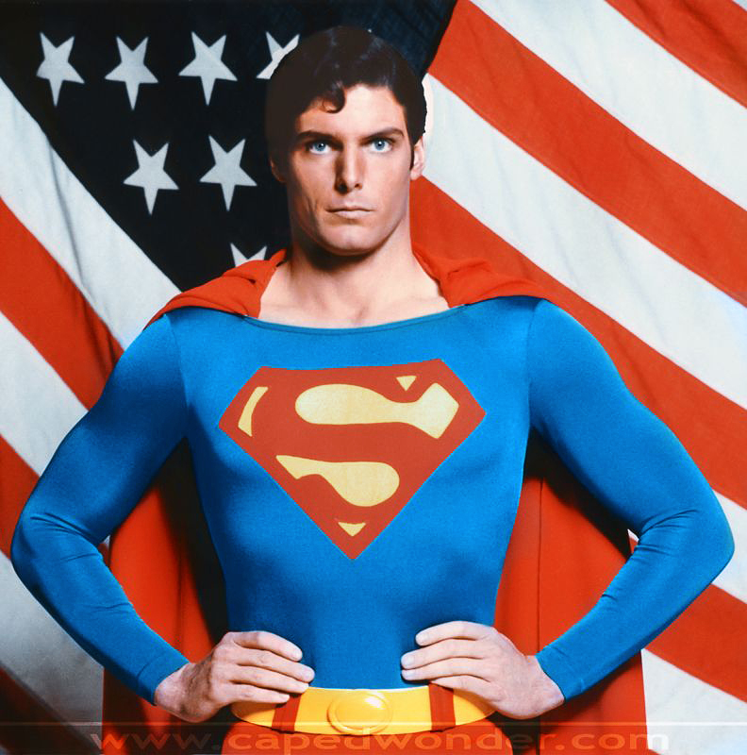

Slide 18
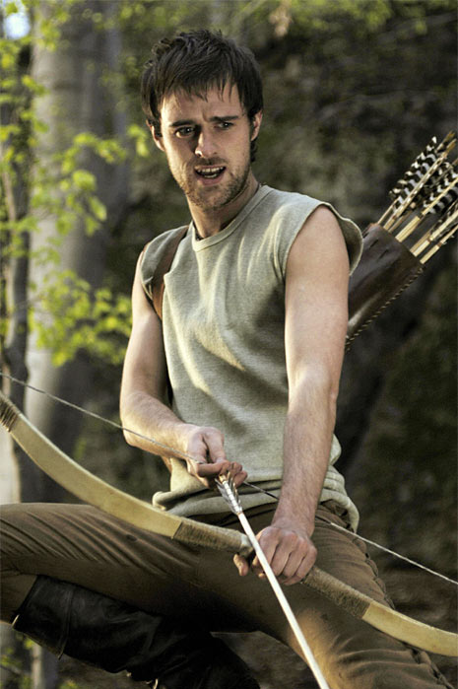

Slide 19
From these images, we can say that:
Heroes tend to be….
Villains tend to be…

Slide 20
In pairs…
Evil characters are often shown as being ugly or physically deformed.
Heroes are usually attractive, young and healthy.
Is this fair?

Slide 21
Plenary
Does the media make us shallow? Are we guilty of ‘judging a book by it’s cover’?
Are we obsessed with physical beauty, particularly in connect with our interest in celebrities?
Can you think of any other
negative effects of the media?

